Slide 1
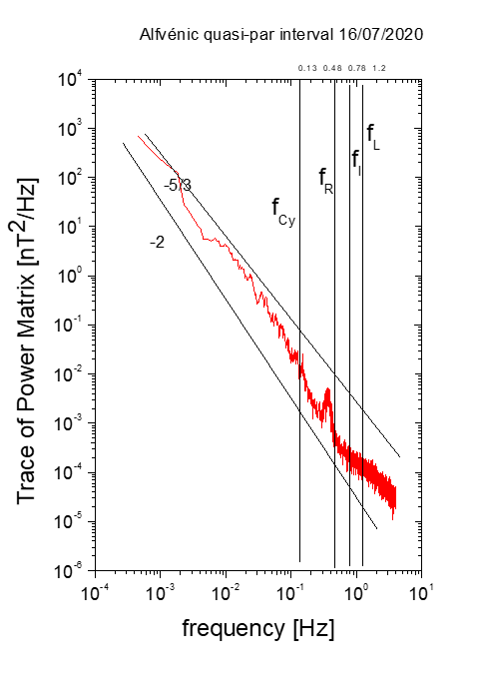
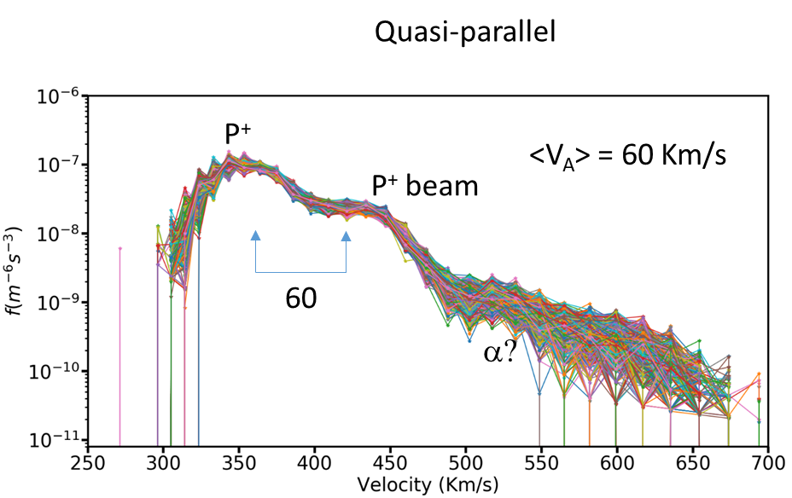
Alfvénic quasi-par interval
ICWs
ICWs
Left handed
Right handed

Slide 2
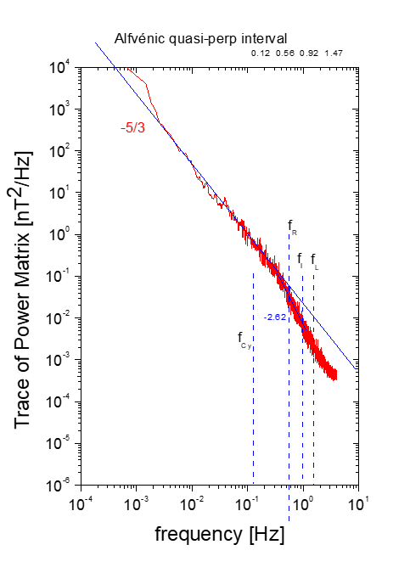
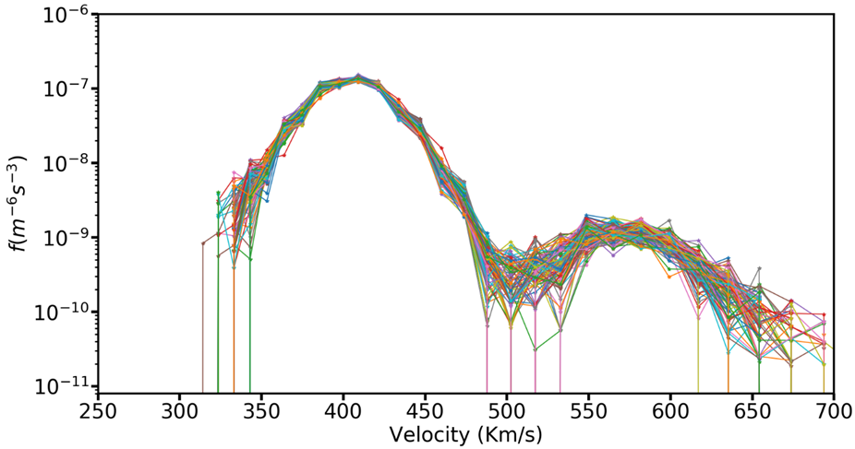
Alfvénic quasi-perp interval
Left handed
Right handed
KAWs

Slide 3
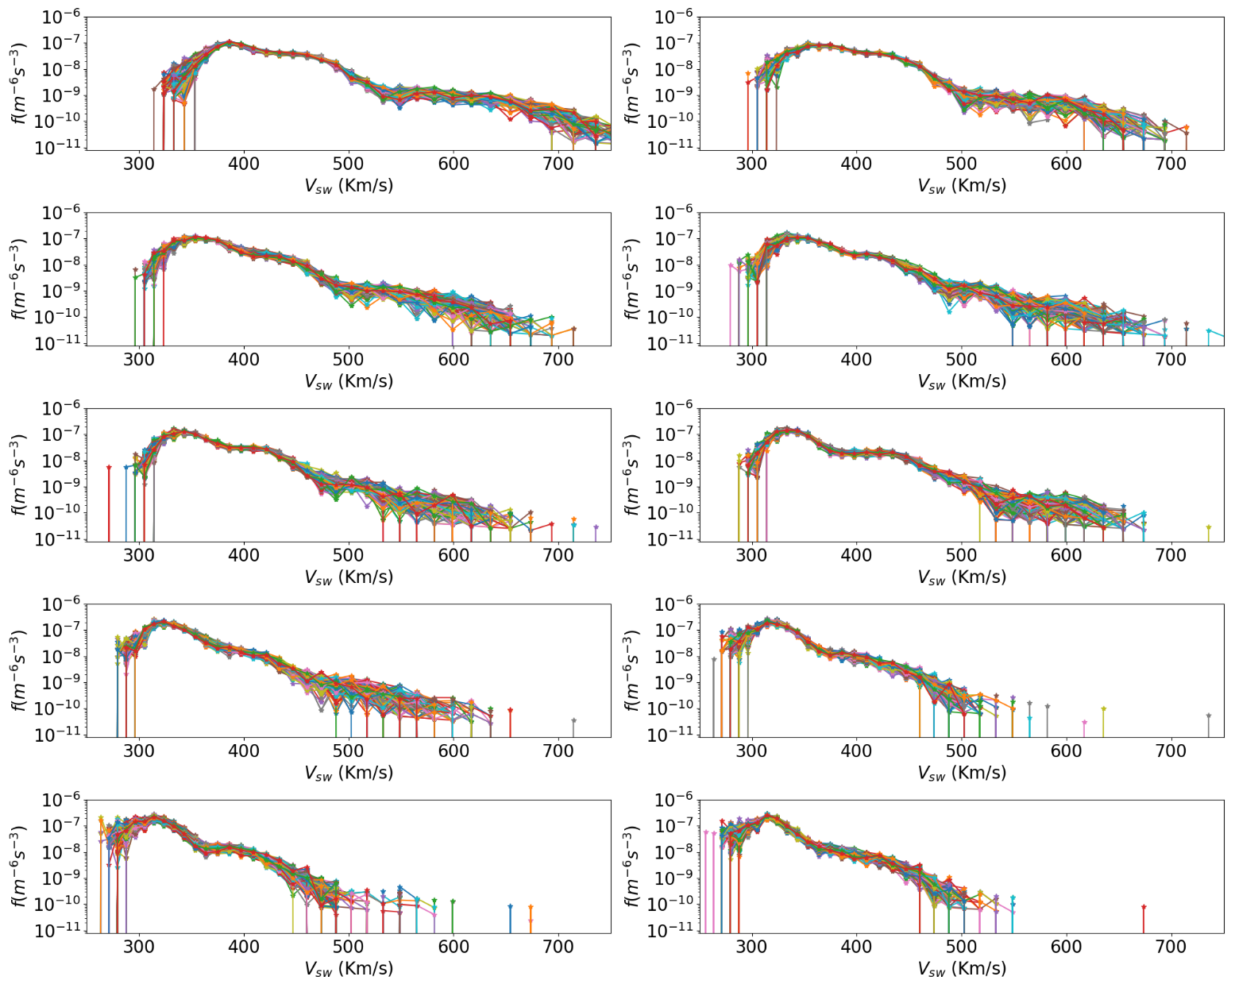
Alfvénic quasi-parallel intervals: 0°< Θ_{BR}< 20°

Slide 4
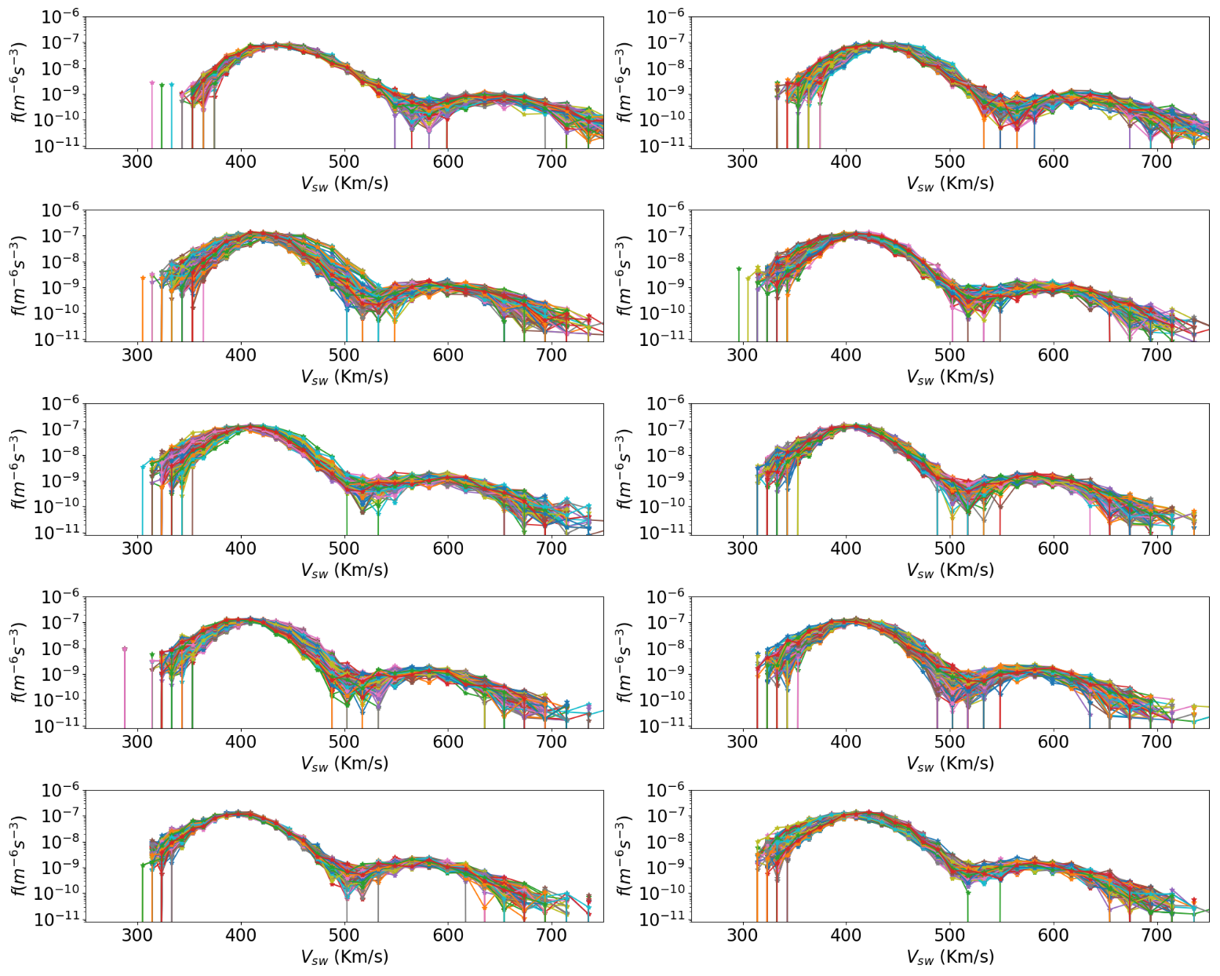
Alfvénic quasi perpendicular intervals: 50°< Θ_{BR}< 90°

Slide 5
summary
Based on what we have seen so far, if there are not ICWs (within quasi-par intervals) there is no beam.
This does not necessarily mean that the ICWs produce the beam.
ICWs and beam might be two different effects of the interaction of Alfvén waves with protons at scales around the frequency break.
Probably we observe beams only when we sample in the quasi-par direction because beams lie on that direction. (sampling direction effect??)
Next step: using 2D cuts in the VDF, we will look for beams also within quasi-perp intervals

Slide 6
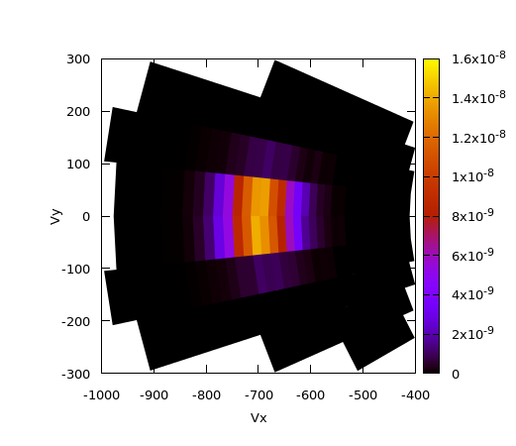
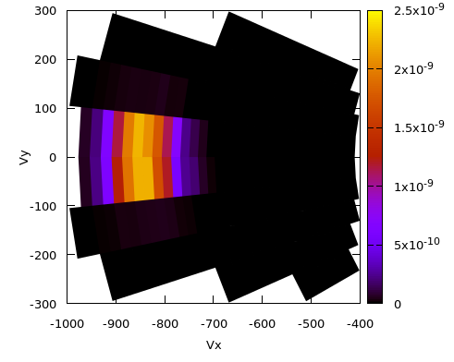
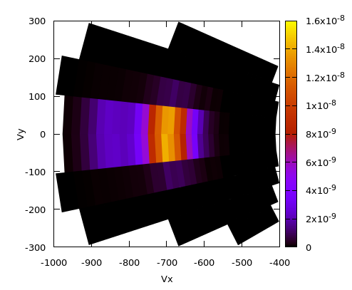
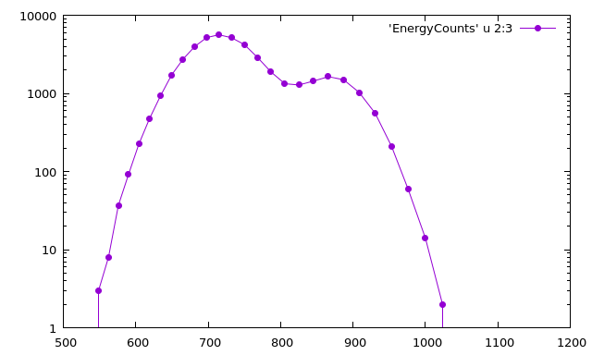
Vx Vy plane, B parallel to Vx, vdf not in scale
Principal
Beam
B, V
Sum

Slide 7
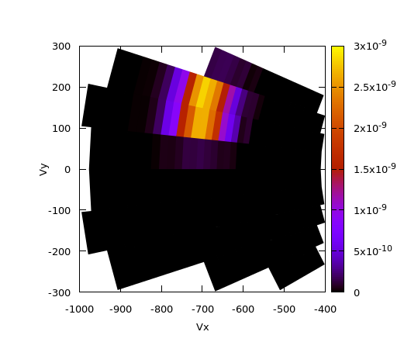
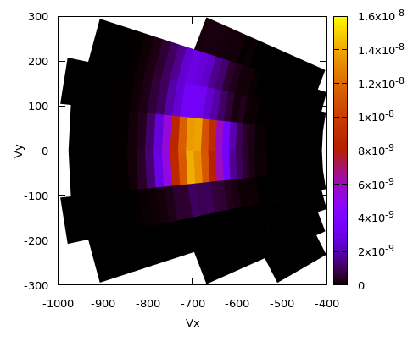
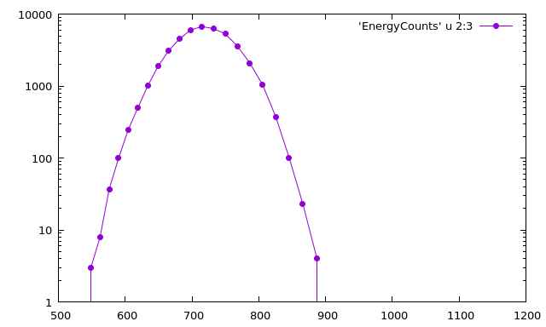
Vx Vy plane, B Perp to Vy, vdf not in scale
V
B
Principal
Beam
Sum

Slide 8
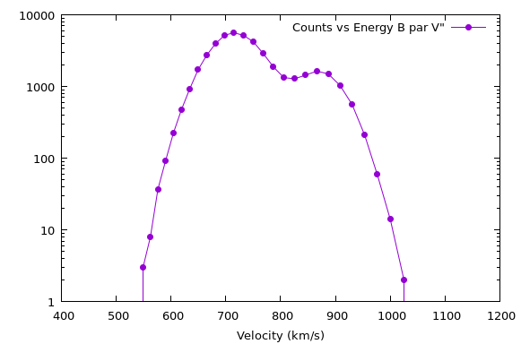
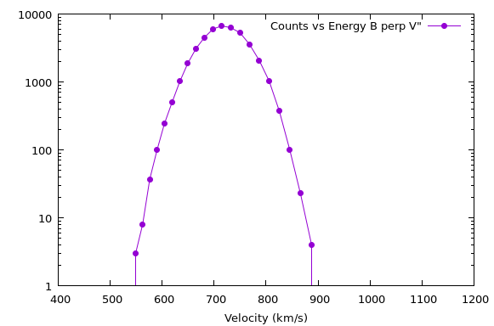
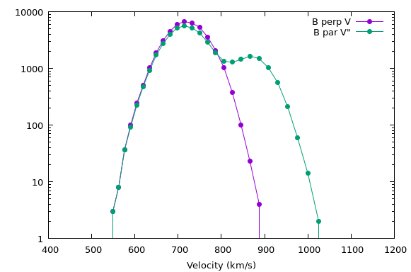

Slide 9
summary
Based on what we have seen so far, if there are not ICWs (within quasi-par intervals) there is no beam.
This does not necessarily mean that the ICWs produce the beam.
ICWs and beam might be two different effects of the interaction of Alfvén waves with protons at scales around the frequency break.
Probably we observe beams only when we sample in the quasi-par direction because beams lie on that direction. (sampling direction effect??)
Next step: using 2D cuts in the VDF, we will look for beams also within quasi-perp intervals
YES!

