Slide 1
Heavy Ion Sensor He²⁺ and O⁶⁺ Distribution Functions
Stefano Livi and the HIS Team
(210) 522-3310
slivi@swri.edu

Slide 2
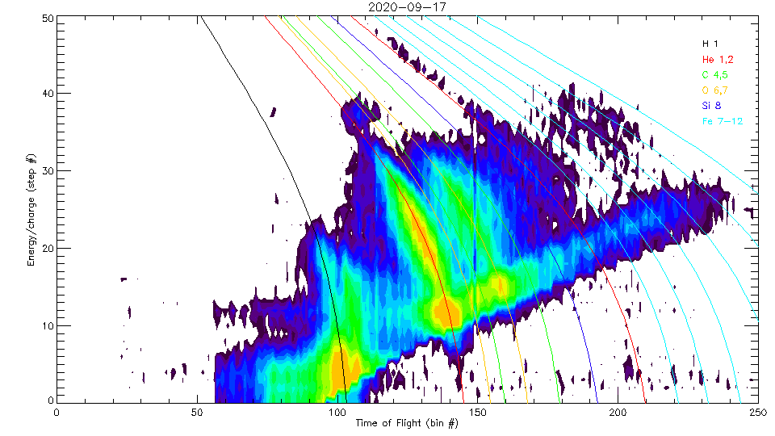
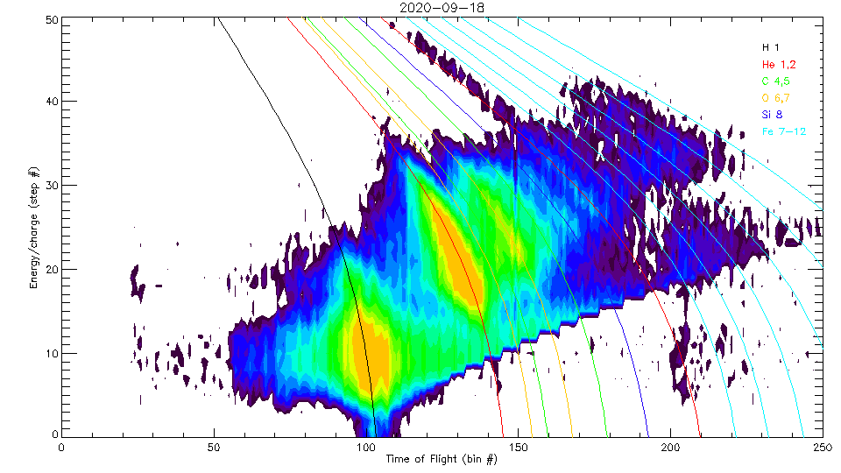
Oxygen 6+ Data at 10kV Post-acceleration
SSD need at least 25keV of deposited energy for detecting a signal
10kV post-acceleration means:
Only 10-20% of the protons can trigger SSD
About 40-50% of the Alphas can trigger SSD
Efficiency for higher masses unknown, probably also in the 50% range
HIS is programmed with all lookup tables tuned to 25kV
We plan to change to 10kV lookup tables in the course of next weeks
Notwithstanding these limitations, HIS can still determine velocity and temperatures of Alphas and Oxygen 6+, and isolate O⁶⁺ from others

Slide 3
When Was HIS On?
2020
 | Jan | Feb | Mar | Apr | May | Jun | Jul | Aug | Sep | Oct | Nov | Dec
1 |  |  |  |  |  | 25 |  |  | 10
2 |  |  |  |  |  |  |  |  | 10 | 10
3 |  |  |  |  |  | 25 |  |  | 10 | 10
4 |  |  |  |  |  |  |  |  | 10 | 10
5 |  |  |  |  | 25 |  |  |  | 10 | 10
6 |  |  |  |  |  | 25 |  |  | 10 | 10
7 |  |  |  |  |  |  |  |  |  | 10
8 |  |  |  |  | 25 |  |  |  |  | 10
9 |  |  |  |  |  |  |  |  |  | 10
10 |  |  | 0 |  |  |  |  |  |  | 10
11 |  |  | 0 |  | 25 |  |  |  |  | 10
12 |  |  | 0 |  |  |  |  |  |  | 10
13 |  |  | 0 |  |  |  |  |  |  | 10
14 |  |  |  |  |  |  |  |  | 10 | 10
15 |  |  |  |  |  | 25 |  |  | 10 | 10
16 |  |  |  |  |  |  |  |  | 10 | 10
17 |  |  | 0 |  |  |  |  |  | 10 | 10
18 |  |  |  |  |  |  |  |  | 10 | 10
19 |  |  |  |  |  |  |  |  | 10
20 |  |  |  |  |  |  |  |  | 10
21 |  |  |  |  |  |  |  |  | 10 | 10
22 |  |  |  | 0 |  | 25 |  |  | 10 | 10
23 |  |  |  |  |  | 25 |  |  | 10 | 10
24 |  |  |  | 0 |  | 25 |  |  | 10 | 10
25 |  |  |  |  |  | 25 |  |  | 10 | 10
26 |  |  |  |  |  | 25 |  |  | 10
27 |  |  |  |  |  | 25 |  |  | 10
28 |  |  |  | 0 |  | 25 |  |  | 10
29 |  |  |  | 0 |  | 25 |  |  | 10
30 |  |  |  |  | 25 | 25 |  |  | 10
31 |  |  |  |  | 25

Slide 4
Alphas and Oxygen Distributions

Slide 5
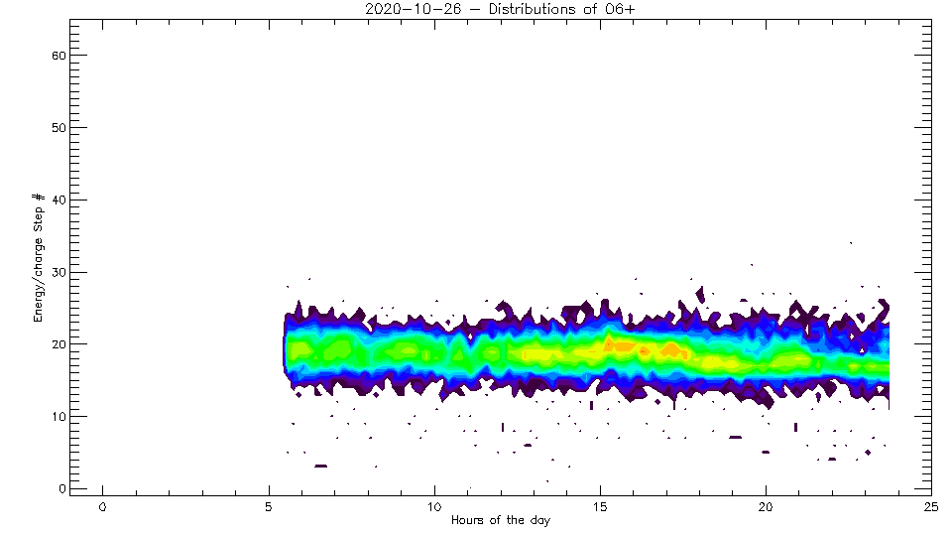
Latest Data

Slide 6
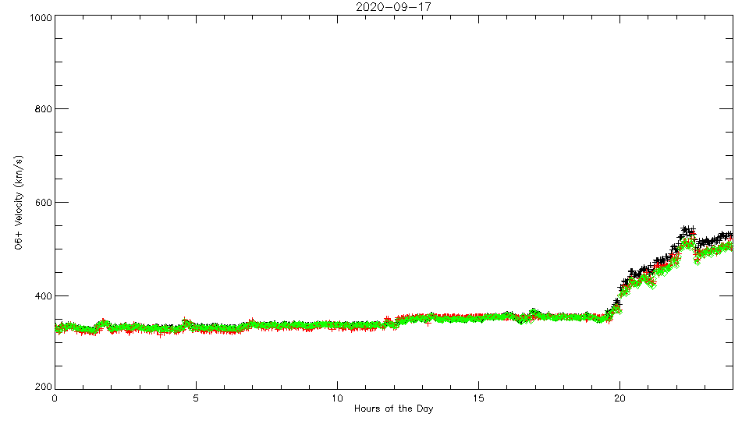
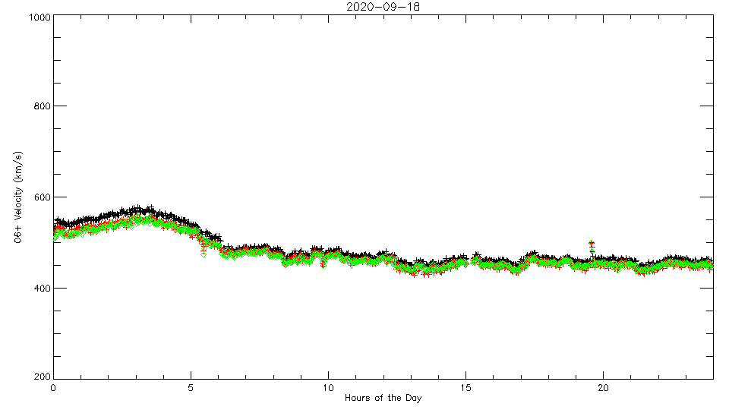
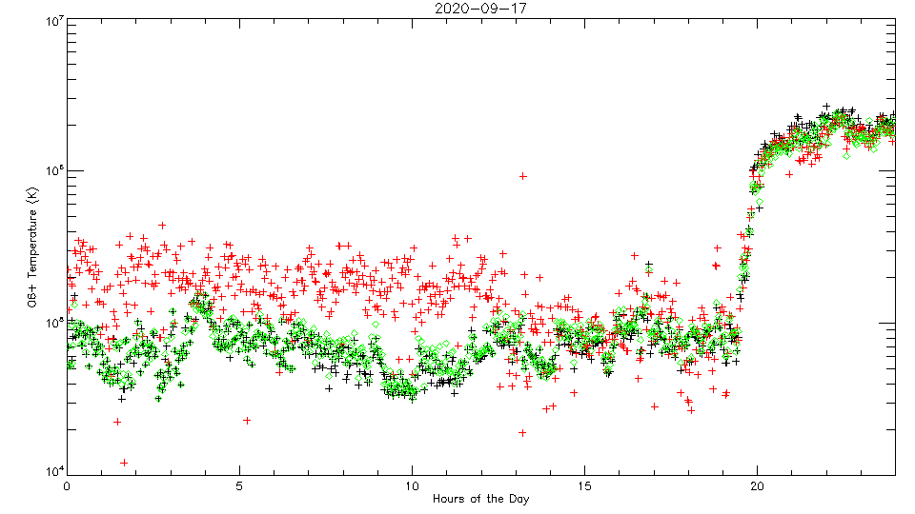
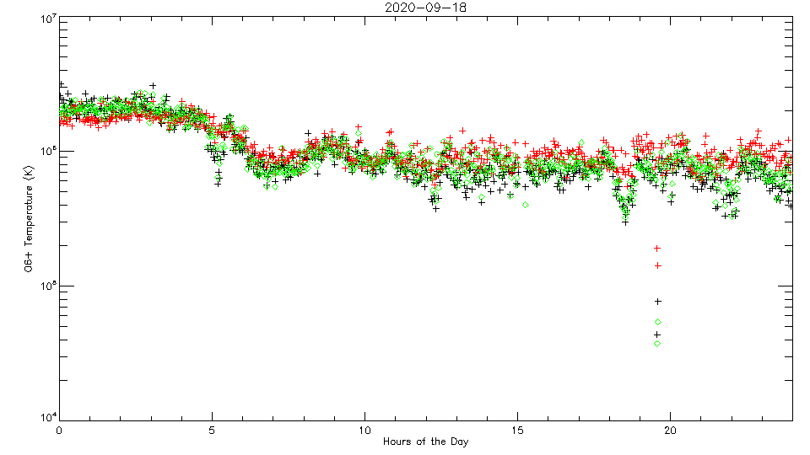
Oxygen 6+ Data at 10kV Post-acceleration, 120s Resolution
Shock
Velocity
Temperature

Slide 7
Oxygen 6+ Velocity and Temperature
A
B
C
D
Collected during September 17 and 18
Three traces for three different evaluation algorithms
Velocity corresponds rather well with PAS proton measurements in A and D
Velocity of O is larger than H in C, supposedly related to the Alfven velocity (need B values for that)
Temperature hitting 16X of H in C

Slide 8
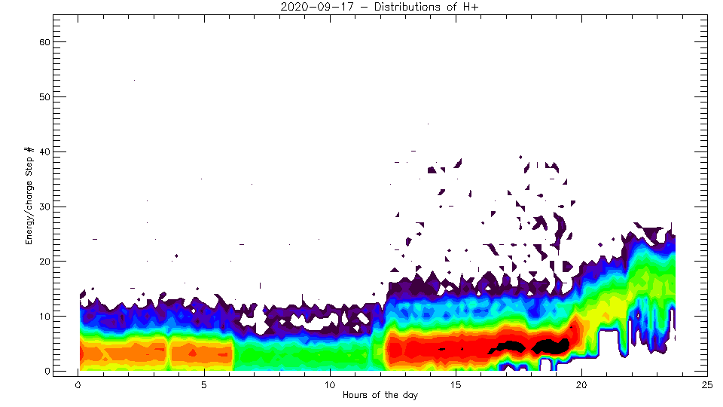
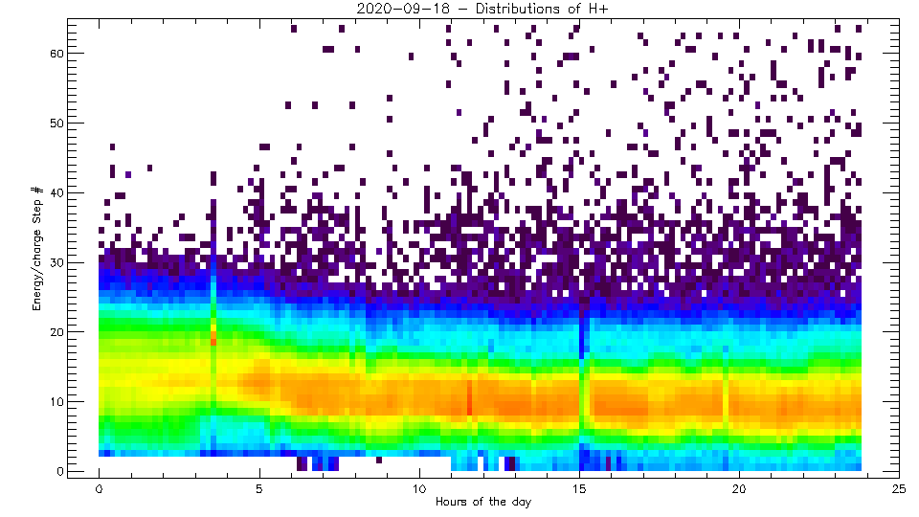
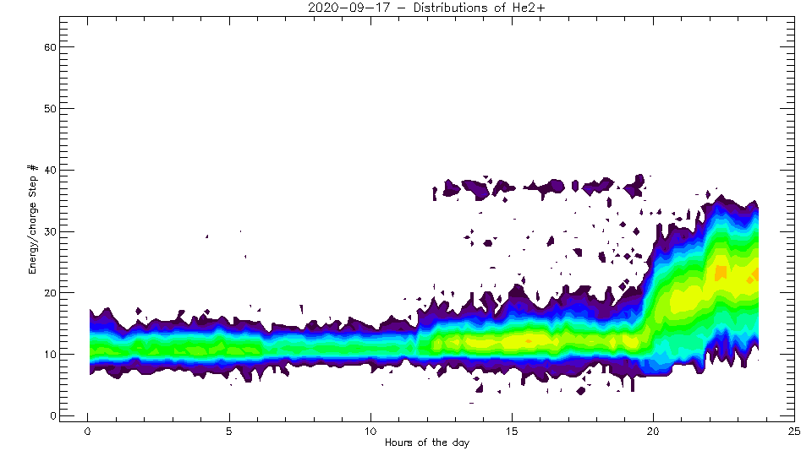
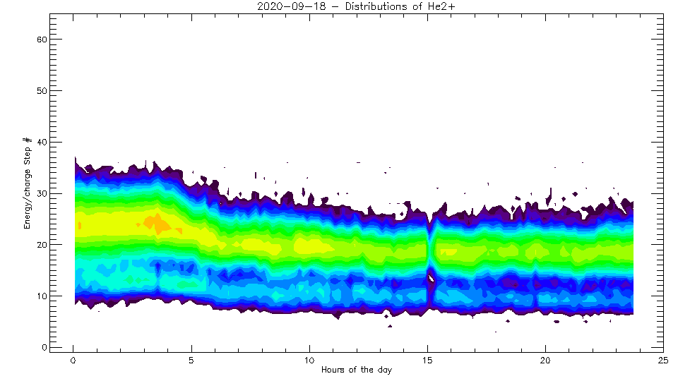
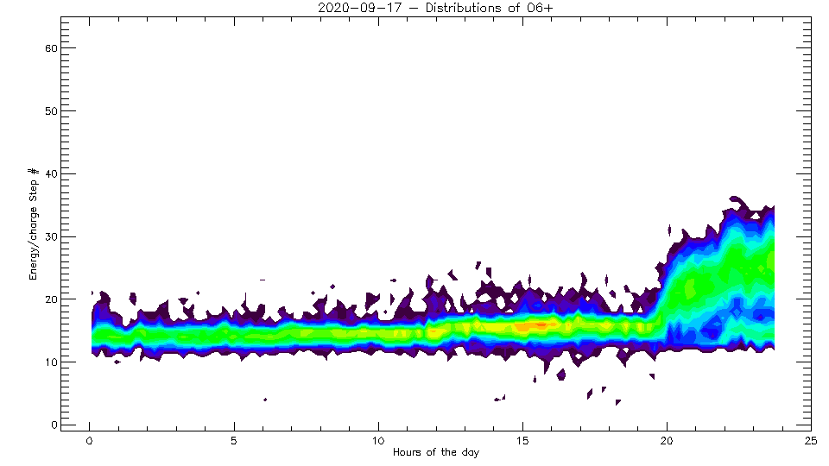
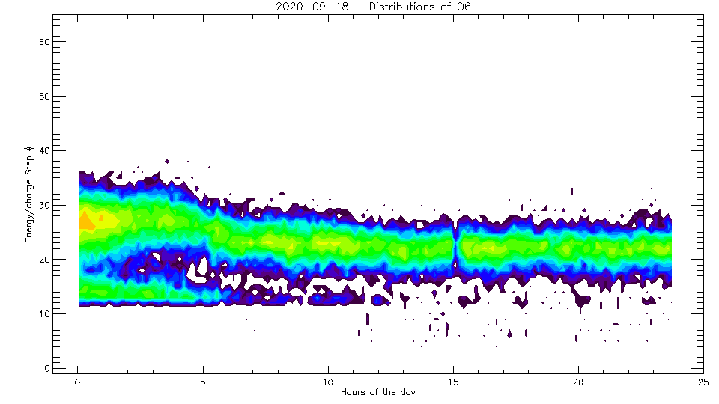

Slide 9
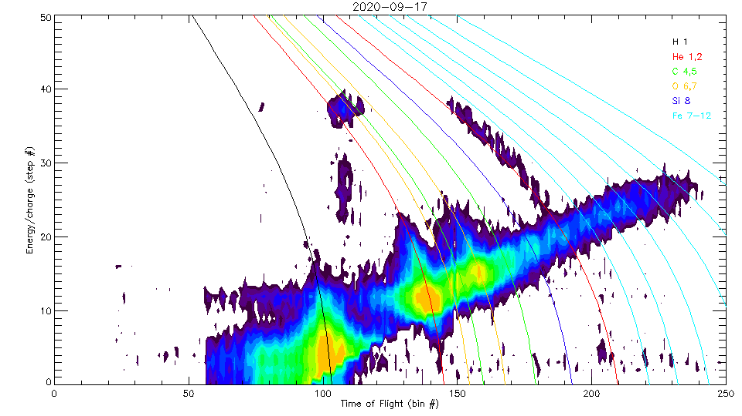
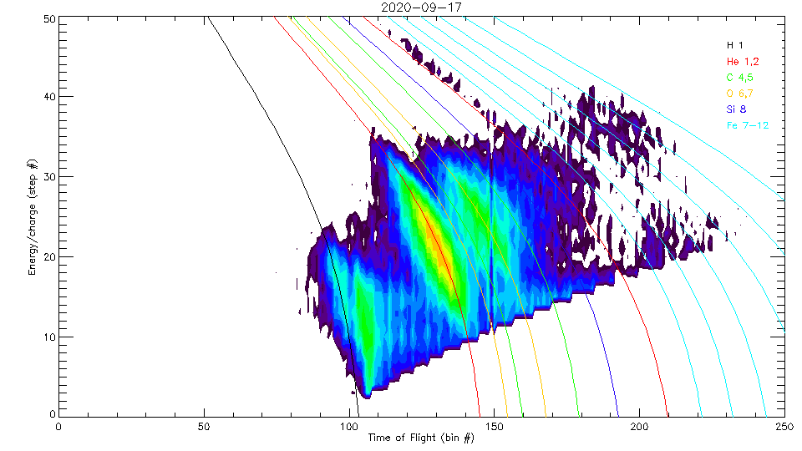
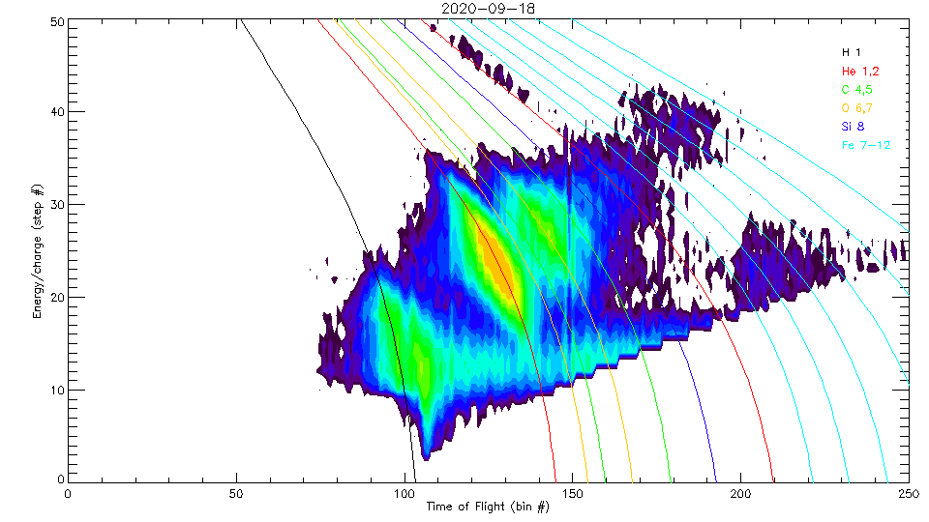
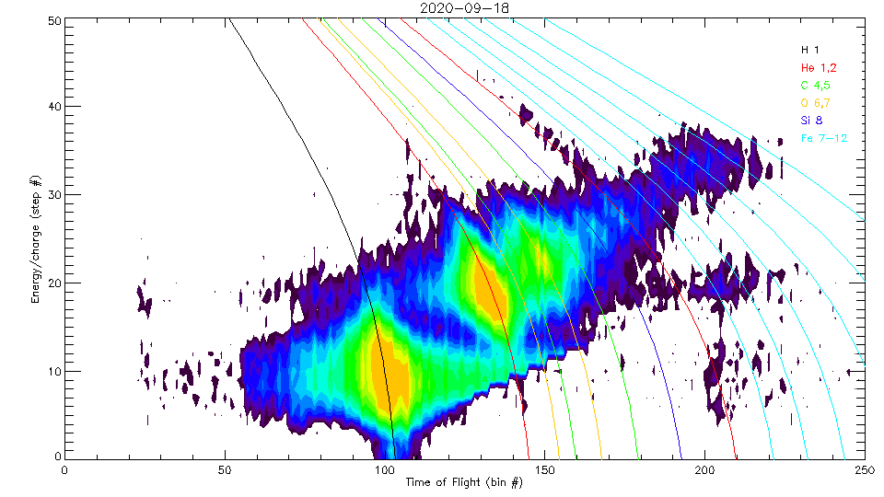
How about Minor Ions?
Work in progress
A
B
E/q
ToF
C
D

