Slide 1
Heavy Ion Sensor Present Status – Part 1
Stefano Livi and the HIS Team
(210) 522-3310
slivi@swri.edu

Slide 2
Agenda
Basic instrument description
Instrument performance to date
HV ramp down
HIS data collected so far
Operations at 10kV
Further activities
HIS as installed on the S/C

Slide 3
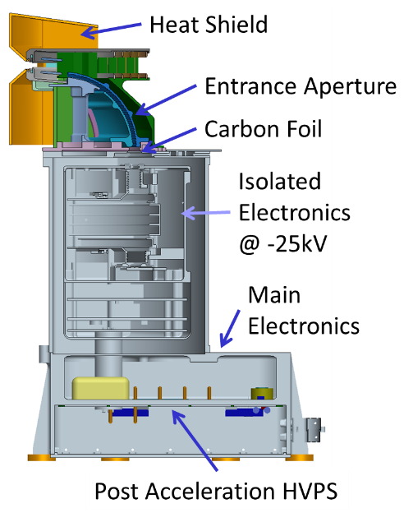
HIS Introduction
The Heavy Ion Sensor (HIS) has been developed to measure distribution functions of heavy ions (i.e. m≧4) in the solar wind
Physical properties of heavy ions carry important information about processes governing the outflow of the solar wind:
Charge states of the heavy ions are established very low in the corona and controlled by the local electron temperature and density
Relative abundances of ions are affected by how long those particles were subject to the gravitational potential of the Sun or other fractionation processes
The distribution functions of the ions trace the plasma processes that are at work during the expansion
Instrument design is based on the combination of an electrostatic analyzer (to select E/q and directions of arrival), followed by a post-acceleration, and a time-of-flight – total-energy measuring system.

Slide 4
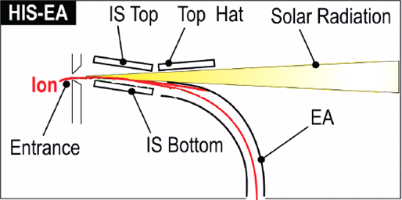
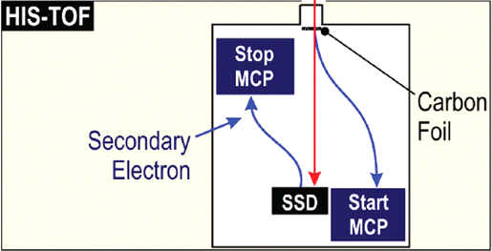
HIS - 101
Postacceleration

Slide 5
Effects of Missing Service 20 Packets
Service 20 (aka S20) is sent from the S/C to SWA every 125ms. Can be considered as an heart beat
The S/C signals to SWA of an impending issue (attitude loss, thruster firing, …) by stopping S20
Power may be taken away from SWA in as short as 60 seconds. Note that power as well as current return line are disconnected
HIS, sitting at 25kV, can lower this voltage:
In 48 minutes - normal, no risk – Ramp rate ~10V/sec
In 10 minutes - some stress to the post-acceleration (PA) power supply, but can be done many times without risk of a permanent damage – Ramp rate 50V/s
In 1 minute to 19kV – ramp rate 220V/s, followed by a 9 minutes ramp to 0 – Ramp rate 23V/s – stress to the insulators and PA, can be exercised N times, with 10 < N < 100
HIS sitting at 10kV
Power can be taken away immediately, no risk

Slide 6
Spacecraft Commanding (aka NCR-1419)
Even before launch, we were afraid of "double miss" command (aka NCR 1419), where missing two consecutive commands would cause spacecraft to turn off S20 to the instrument
This happened to SWA during ground operation on the ETB
This might have caused severe effects during commissioning
ESA/Airbus performed a patch on the flight software, whereby a missing Service 20 message would not count as a missed command
This did not reduce the frequency of FDIR interventions
This FDIR is related to the command “read_DPU_error_log”, issued every day at 23:59
After this command has been banned by the S/C, this FDIR did not reproduce
We believe this error is caused by routing a >500 bytes packet to the OBC
Plan is been developed to route this packet to the SSMM
Note that, during commissioning, SpaceWire exhibits other problems at spacecraft level:
On two instances, clogging of SpaceWire bus by instrument A did produce "multiple errors" and hence reboots on instrument B and C
On one instance, heavy commanding of instrument D produce a collapse of the spacecraft messaging system, and spacecraft went into safe mode

Slide 7
DPU Unplanned Reboot
Cause of these reboots is currently not known
During reboot, DPU does not answer to a S20, triggering the NCR-1419
HIS presently needs to react to a missing S20 as if S/C would turn off power in 1 minute
Accordingly HIS tries to lower the voltage as far as it can safely be done in 60 seconds
This cannot be done an indefinite number of times.
We have envisioned a plan to determine that the DPU is rebooting, in which case the 25kV can be brought to 0 in 600 seconds
Plan is based on the DPU heart beat (Service 9)
If both S20 and S9 are missing, the DPU is rebooting, and HIS canb p[ower down slowly
If S20 is missing but S9 is present, the S/C is sending a panic message, and HIS needs to lower the voltage fast
This plan requires an update of HIS flight software, but does not require either a DPU software change or a S/C FDIR update

Slide 8
When Was HIS On?
2020
 | Jan | Feb | Mar | Apr | May | Jun | Jul | Aug | Sep | Oct | Nov | Dec
1 |  |  |  |  |  | 25 |  |  | 10
2 |  |  |  |  |  |  |  |  | 10 | 10
3 |  |  |  |  |  | 25 |  |  | 10 | 10
4 |  |  |  |  |  |  |  |  | 10 | 10
5 |  |  |  |  | 25 |  |  |  | 10 | 10
6 |  |  |  |  |  | 25 |  |  | 10 | 10
7 |  |  |  |  |  |  |  |  |  | 10
8 |  |  |  |  | 25 |  |  |  |  | 10
9 |  |  |  |  |  |  |  |  |  | 10
10 |  |  | 0 |  |  |  |  |  |  | 10
11 |  |  | 0 |  | 25 |  |  |  |  | 10
12 |  |  | 0 |  |  |  |  |  |  | 10
13 |  |  | 0 |  |  |  |  |  |  | 10
14 |  |  |  |  |  |  |  |  | 10 | 10
15 |  |  |  |  |  | 25 |  |  | 10 | 10
16 |  |  |  |  |  |  |  |  | 10 | 10
17 |  |  | 0 |  |  |  |  |  | 10 | 10
18 |  |  |  |  |  |  |  |  | 10 | 10
19 |  |  |  |  |  |  |  |  | 10
20 |  |  |  |  |  |  |  |  | 10
21 |  |  |  |  |  |  |  |  | 10 | 10
22 |  |  |  | 0 |  | 25 |  |  | 10 | 10
23 |  |  |  |  |  | 25 |  |  | 10 | 10
24 |  |  |  | 0 |  | 25 |  |  | 10 | 10
25 |  |  |  |  |  | 25 |  |  | 10 | 10
26 |  |  |  |  |  | 25 |  |  | 10
27 |  |  |  |  |  | 25 |  |  | 10
28 |  |  |  | 0 |  | 25 |  |  | 10
29 |  |  |  | 0 |  | 25 |  |  | 10
30 |  |  |  |  | 25 | 25 |  |  | 10
31 |  |  |  |  | 25

Slide 9
What HIS Can Do at 10 kV
SSD need at least 25keV of deposited energy for detecting a signal
10kV post-acceleration means:
Only 10-20% of the protons can trigger SSD
About 40-50% of the Alphas can trigger SSD
Efficiency for higher masses unknown, probably also in the 50% range
HIS is programmed with all lookup tables tuned to 25kV
We plan to change to 10kV lookup tables in the course of next weeks
Notwithstanding these limitations, HIS can still determine velocity and temperatures of Alphas and Oxygen 6+
It was possible to optimize performances of HIS in several areas:
Proton avoidance threshold
Time-of-flight bin to ns conversion
SSD noise thresholds

Slide 10
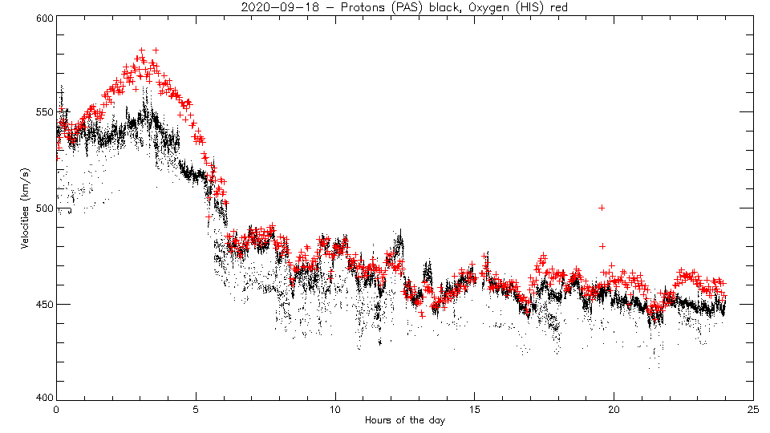
HIS and PAS Velocities and Temperatures

Slide 11
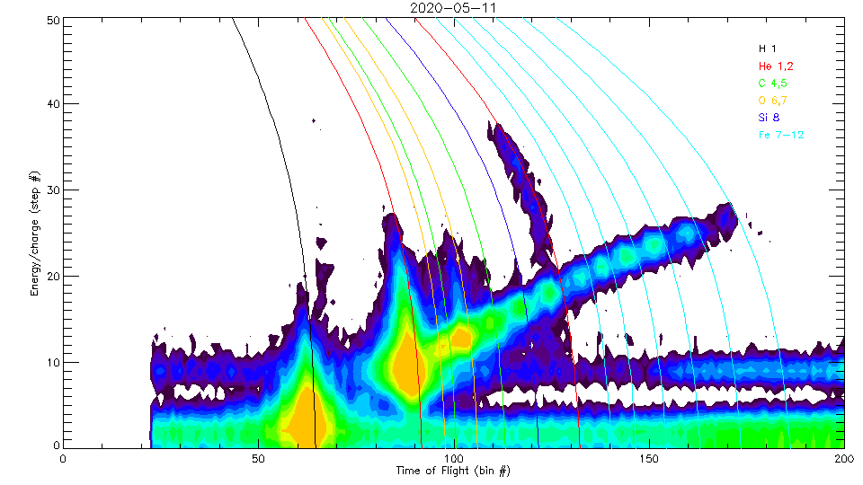
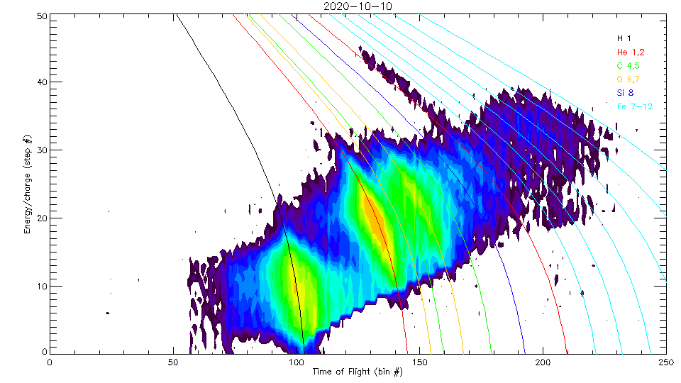
Proton Avoidance
Too high flux overloads the sensor and creates artificial double coincidences
E/q proceeds from high to low values
Proton avoidance kicks in when countrate exceeds a set value
Original 100k
First step 50k
Now at 25k
Note that the top picture was collected at 25kV, the lower at 10kV

Slide 12
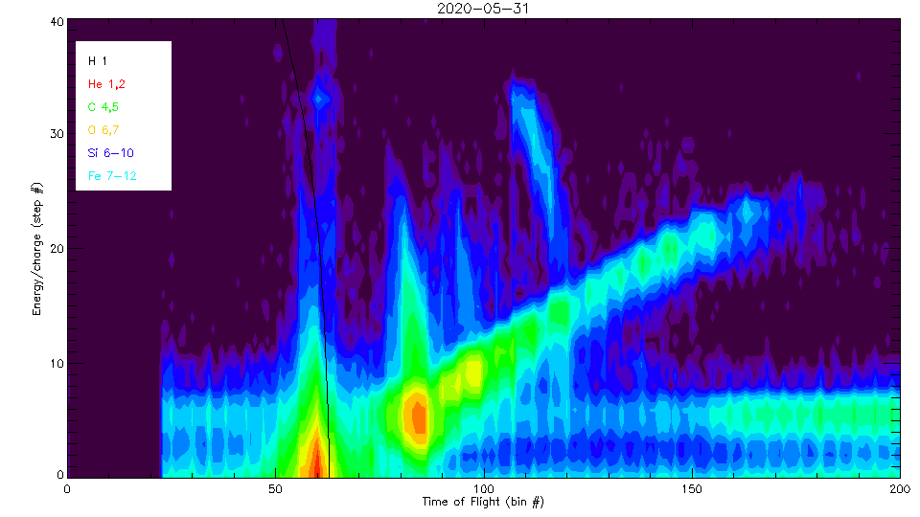
Time Conversion
Time of flight of the particles is determined by a Vernier system: conversion of bin number into ns is controlled by the difference of two oscillators running at slightly different frequency
This is very sensitive to temperature: HIS has the internal capability of recalibrating the conversion
Effect can become very large, in flight we have experience up to 10% variations
During calibration, this happened every run (every minute or so); in flight this was not done, and oscillators drifted
A permanent cure will be implemented in flight software, recalibration every scan (30s). For the time being, we force a recalibration every 60minutes, requiring commanding HIS every hour

Slide 13
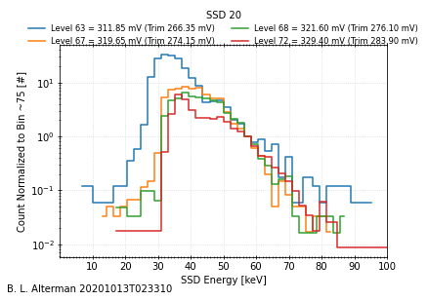
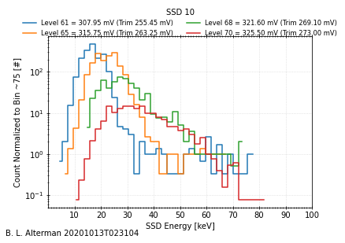
SSD Noise Thresholds
In flight performances of the SSD were different than observed on ground. This is not unusual, as the noise environment is different
We have envisioned a procedure to establish the best operating thresholds once in flight. This procedure did not work, as it was not properly accounting for cross talk between detectors
Following a search pattern is not feasible in flight, as delay between iterations can be as large as 4 weeks (sending one set of thresholds, receiving the data, preparing the next set, creating the new IOR, and uploading it) and having data on the ground can be of order
We have envisioned an approach that delivered good results.
More work is in progress

Slide 14
Further Activities at 10kV
As the risk of having to drop voltage fast is still very high, we have decided to operate further at 10kV.
Science performances are not stellar, but we are already obtaining interesting results (see talks tomorrow)
Further optimization of the sensor (at 10kV) will include:
Further tuning of SSD thresholds
Creating and uploading species boxes tuned to 10kV, based on simulation, as no calibration data was ever performed at this voltage. With these new boxes we will be able to create distribution functions of (at least) alphas and O6+, a valuable science goal on its own!
Creating and uploading priority tables tuned to 10kV to acquire knowledge of the influence of these tables

