Slide 1





SWA Data Processing Unit (DPU)
Roberto Bruno and the DPU Team
SWA Team Meeting #26
Date: 29th and 30th Oct 2020
Location: Online Meeting

Slide 2
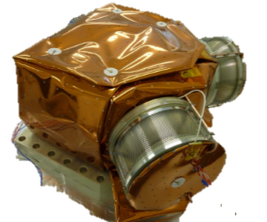
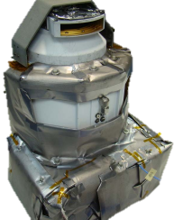
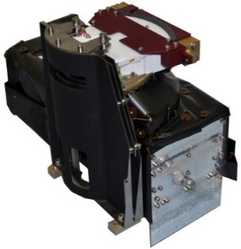
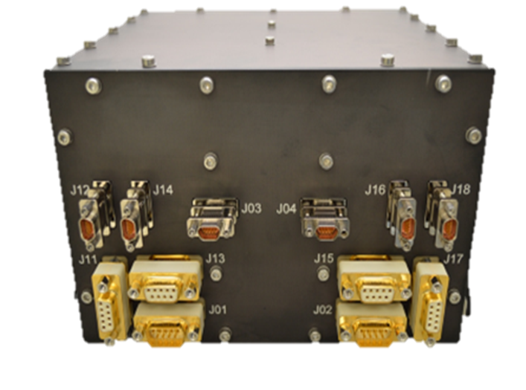
EAS
HIS
The DPU:
is the only SWA interface with the S/C
is interfaced with EAS, PAS and HIS via SpW;
supports EAS and PAS with power, functionality control, temporary storage, communication and computational capability;
supports HIS with communication to the S/C (power directly from the s/c)
PAS
~3.5Kg ~11W
DPU
Onboard Computer

Slide 3
DPU: Data Processing Unit - software
The overall SW consists of two independent executable SW images:
the BOOT SW (BSW) (non volatile memory)
the Flight SW (FSW)
BSW: HW initialization, processor and memory check
FSW: TC validation and execution, TM, DPU and sensors’ state, tasks execution, scientific data processing, exchange of information among the subsystems and between the DPU and S/C, etc...

Slide 4
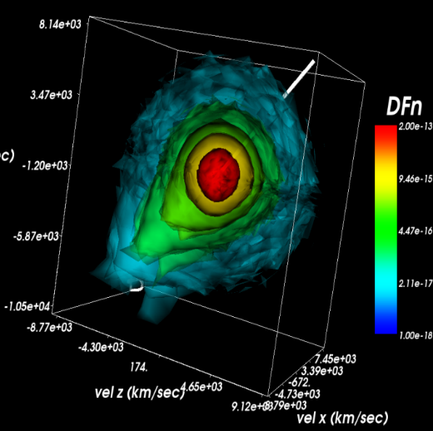
DPU: Data Processing Unit – data crunching
(lossless compression)
e.g. EAS:
VDF acquired as a cube of counts whose dimensions are: Θ, E, Φ
and stored in a one dimensional array (rolling buffer) to be compressed
halo
Best compression ratio reached reorganizing the acquisition sequence (Θ, E, Φ → E, Φ, Θ) in order to reduce jumps in the sequence (10% gain) and further applying a reordering mechanism to assure the highest degree of spatial continuity among contiguous samples (17% gain)
EAS CR*……………………..1.9 ÷ 12.1
PAS CR*……………………..3.4 ÷ 17.5
*) depending on data product
core
strahl
B

Slide 5
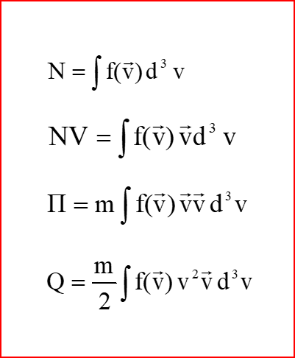
DPU: Data Processing Unit – data crunching
(moments)
The Scientific Data Processing Software (SDPSW) is the component of the FSW in charge of processing data collected by EAS (1 and 2) and PAS sensors
N = number density
NV = number flux density
= pressure tensor
Q = heat flux
only 13 parameters

Slide 6
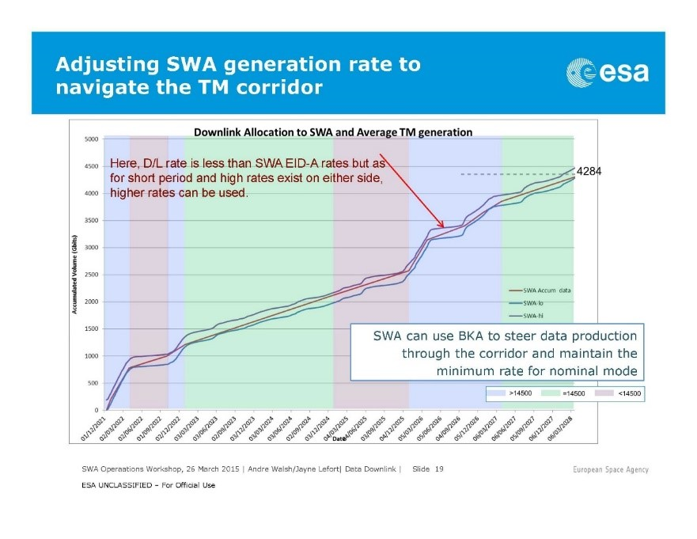
DPU: Data Processing Unit – the BK algorithm (BKA) 1/2
The book-keeping algorithm (CJO) is a completely autonomous software tool to monitor and control the amount of BM produced along the orbit by each sensor.

Slide 7
DPU Status
The DPU successfully completed the commissioning without any problem detected and then started the cruise phase in June.
Since then the DPU has operated successfully for a total of about 2473 hours:
  More than 9860 commands received and handled (executed or rejected)
  More than 71218160 Service 20 received and handled (routed to the sensors)
  More than 5148525 of TM packets generated (HK, Report and Event TM)
  More than 6352100 of Science TM packets generated
There are two main issues detected in this operative phase:
  Spontaneous DPU Reboot (9th July, 30th September, 19th October, 28th October)
  DPU not responsive for 5ms with the transmission of the TC_ERR_LOG_DUMP command. This issue occurred 3 times at mid August at 23.59, the command was banned from the timeline.

