Slide 1
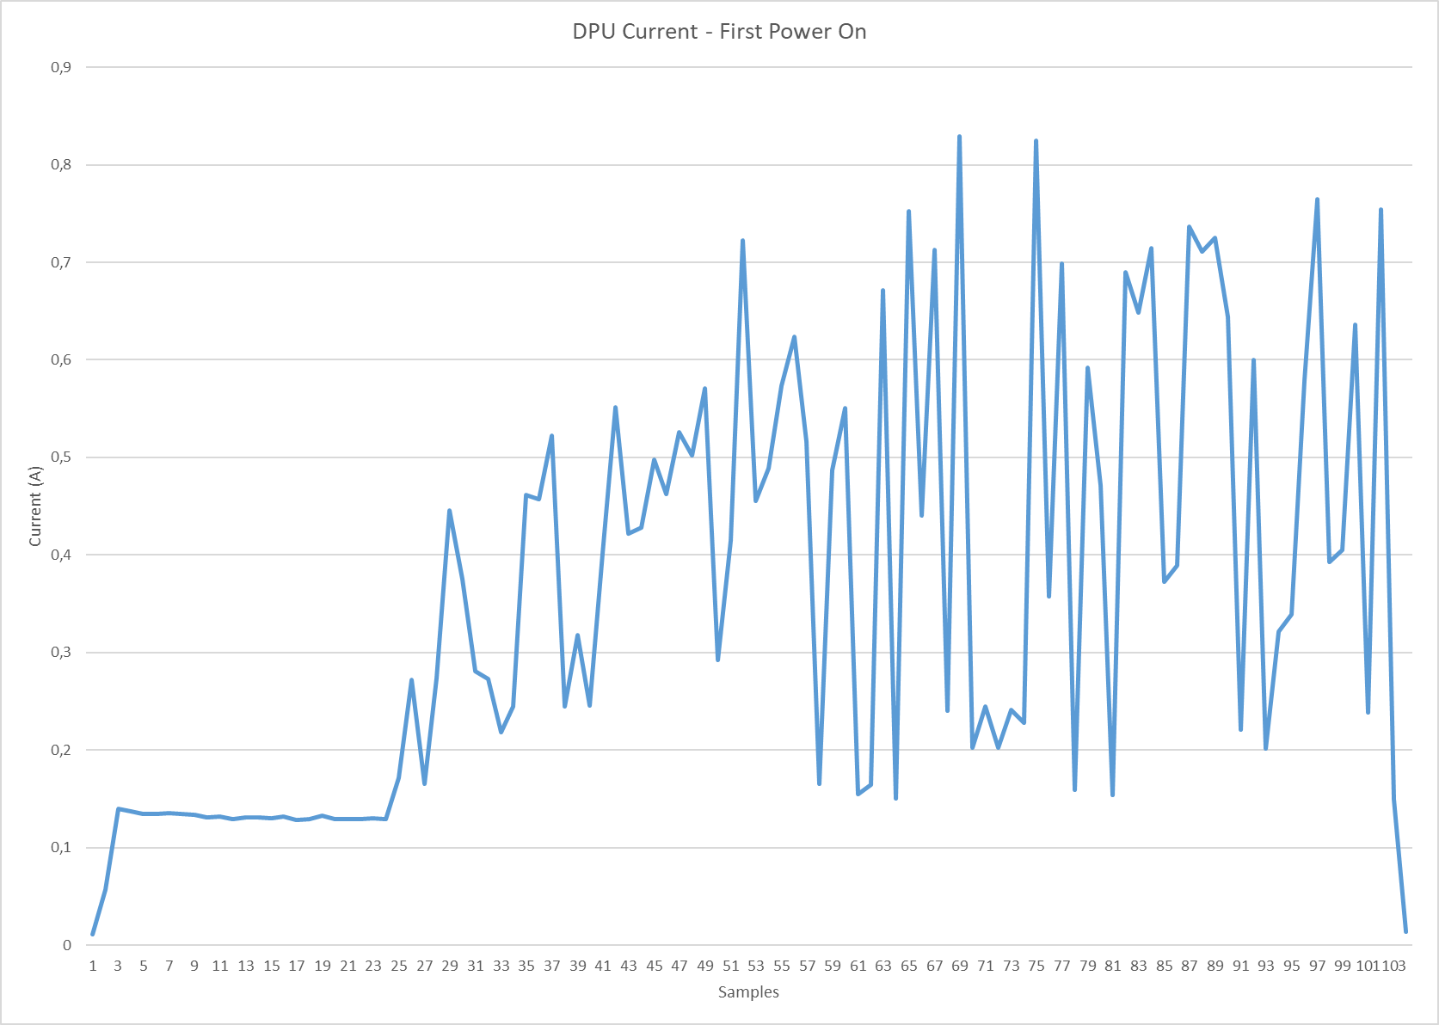
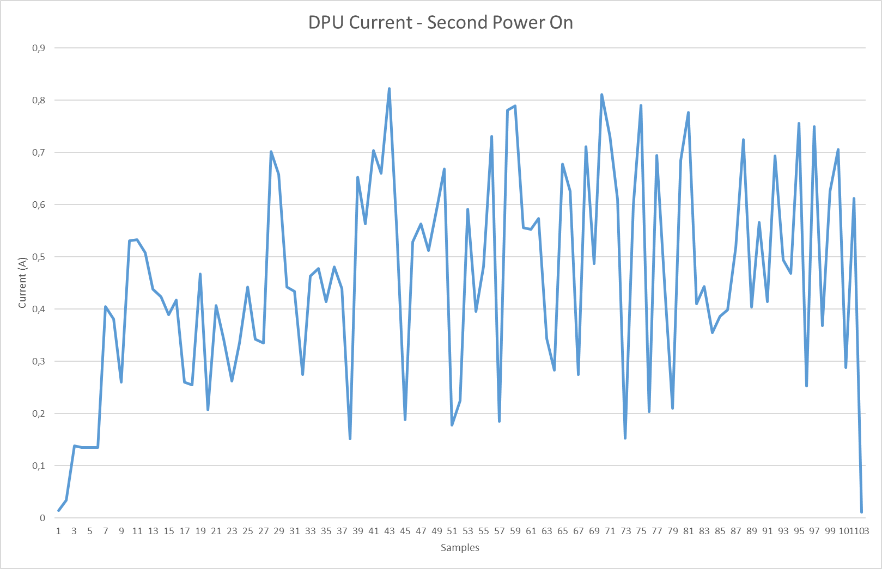
DPU Nominal - Power On Issue
The 03/11/2020 the DPU was powered on, but no TM was received by the S/C. When the S20 was enabled according the MTL the command was not accepted by the DPU and the OBC FDIR was triggered and DPU was powered off.
The acquired TMs shown that SWA LCL A was ON & RSA was ON but No current sample was received during the period between switch-on and FDIR trigger. For this reason SWA team required to repeat the power on acquiring DPU current HK at 1Hz instead of 5 minutes and repeat the test one time configuring as active communication link the SpaceWire Nominal and the second time the Spacewire Redundant.
The 10/11/2020 the test was executed but DPU power on failed in both test configurations, no TM was received by the S/C and the following DPU Current profiles are acquired:

Slide 2
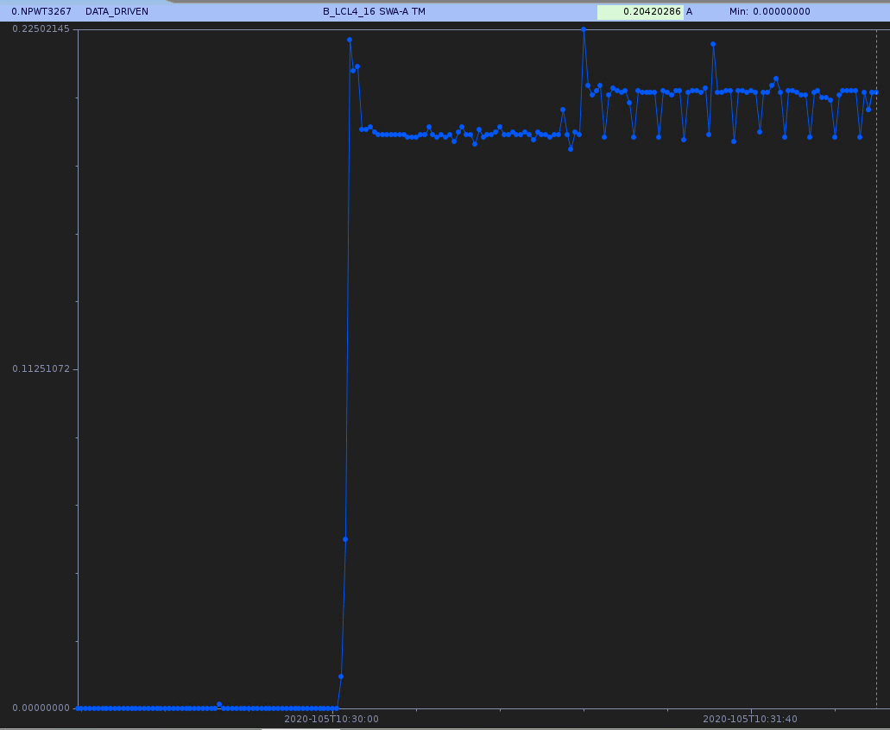
DPU Nominal - Power On Issue
In the following is reported the typical profile of the DPU current acquired during the commissioning.

Slide 3
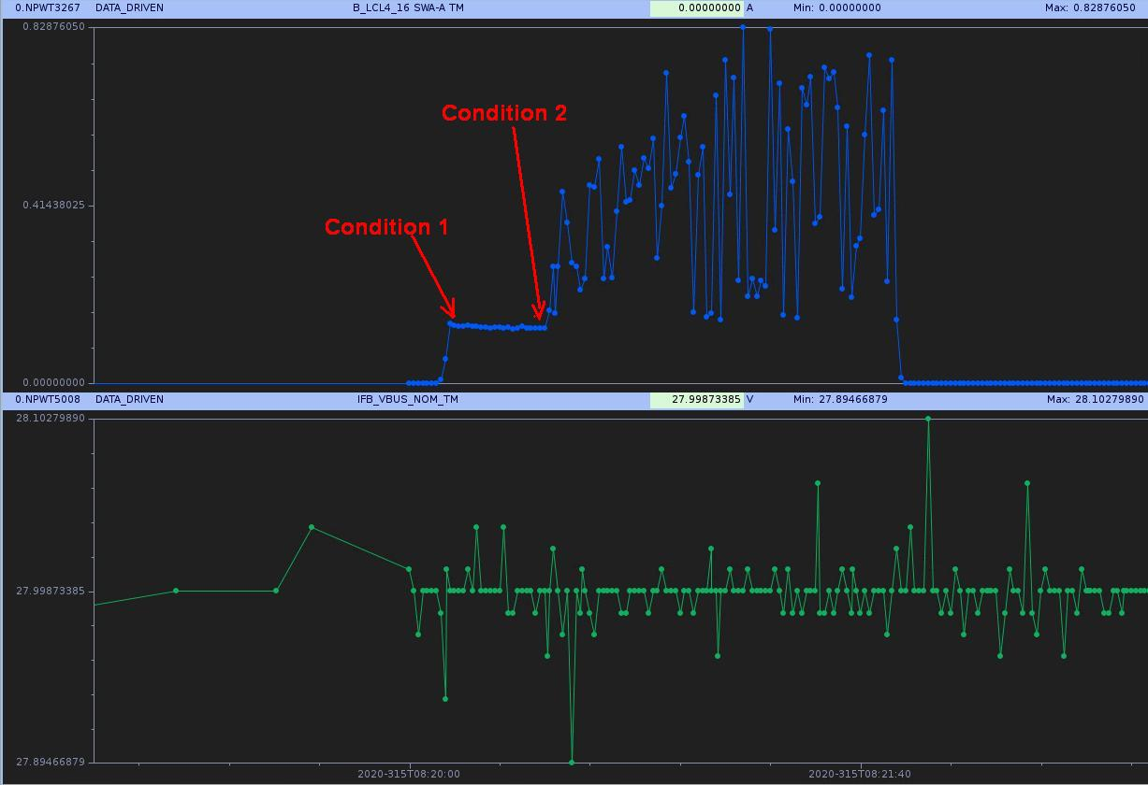
continuously
DPU Nominal - Power On Issue
In the figure, voltage and current profiles @ 28V of the first failed power ups of the DPU.
Two condition are highlighted:
Condition 1, after switch-on the current is quite constant, but its value (~0.14A) is below the nominal one, that is around 0.20A when the Boot SW is running
Condition 2, after 20-25 seconds the current begins to increase (up to ~0,82A) and oscillate continuously

Slide 4
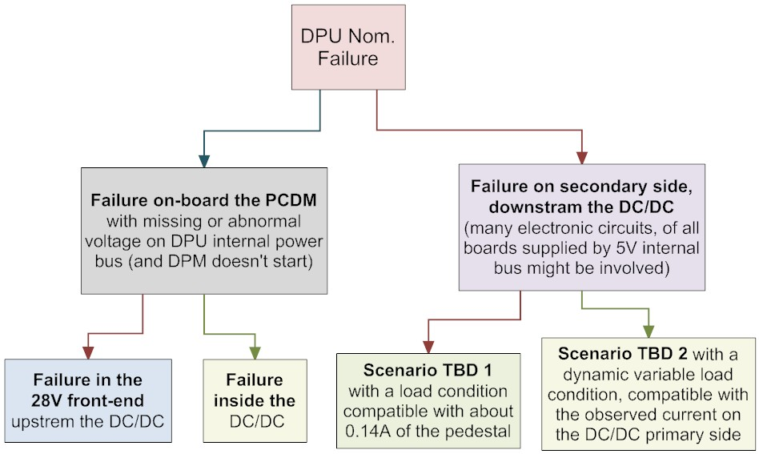
DPU Nominal - Power On Issue
The issue analysis is still in progress, unfortunately some data (e.g. SpaceWire link status) that will allow to clarify the operational status of the DPU are not available but in any case some hypotheses are already made; in the figure is shown the hypothesized “failure tree”.

