Slide 1
Outline of issue
27th October 03:08. DPU uncontrolled Reboot
Decided to leave SWA off due to Maint activities the following week
30th October. DPU powered off by ground command
03rd Nov 01:00. SWA recovery started. FAILED.
No TM coming from SWA
No LCL current measurements available
10th Nov ~08:30 Power On test
SC HK rate increased to 1sec
Power on PRIME DPU for with PRIME SpW connection
DPU should go through Boot and go into ASW.
After 100 seconds, DPU powered off by ground command
Results:
No TM
Normal LCL current for ~25 seconds then erratic LCL current until power down
Test repeated on PRIME DPU with REDUNDANT SpW connection
Results:
No TM
Normal current for ~7 seconds then erratic until power down

Slide 2
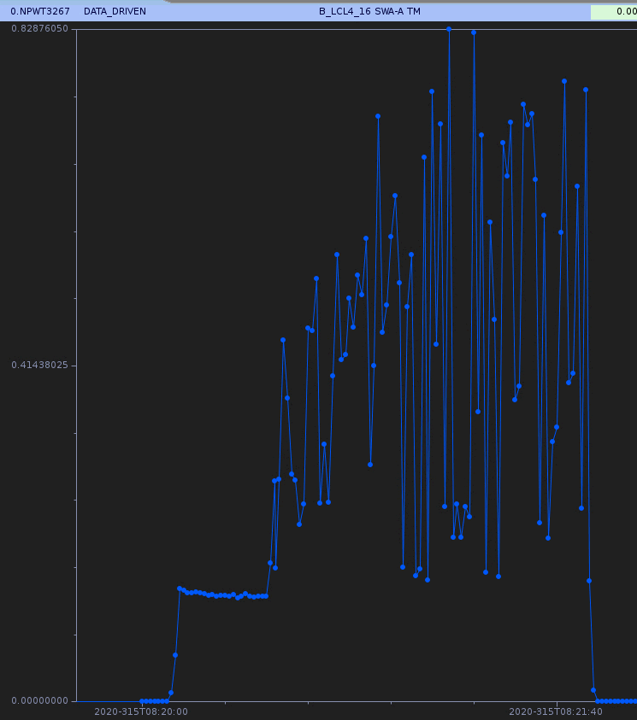

Slide 3
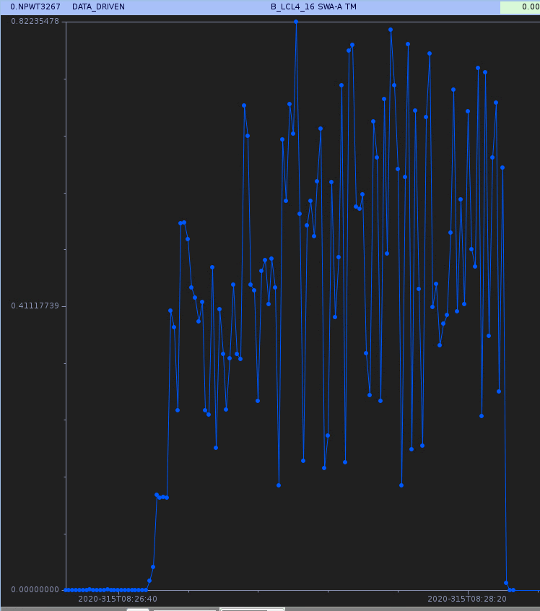

Slide 4
0.225 A ---
0.112 A ---
0.000 A ---
0.828 A ---
0.414 A ---
0.000 A ---
28.10 V ---
27.99 V ---
27.89 V ---
1 min 40 sec

Slide 5
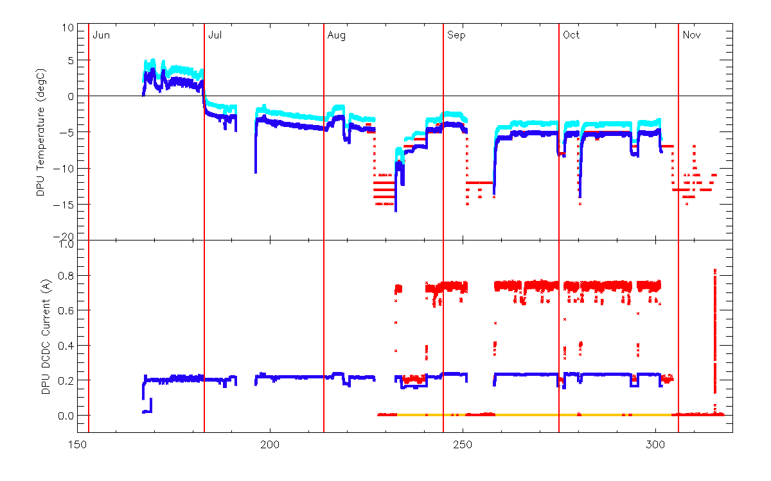

Slide 6
