Slide 1
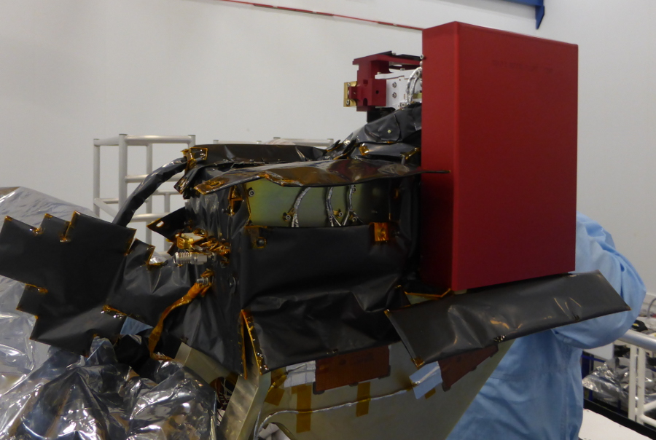
PAS Samplings and L2 products

Slide 2
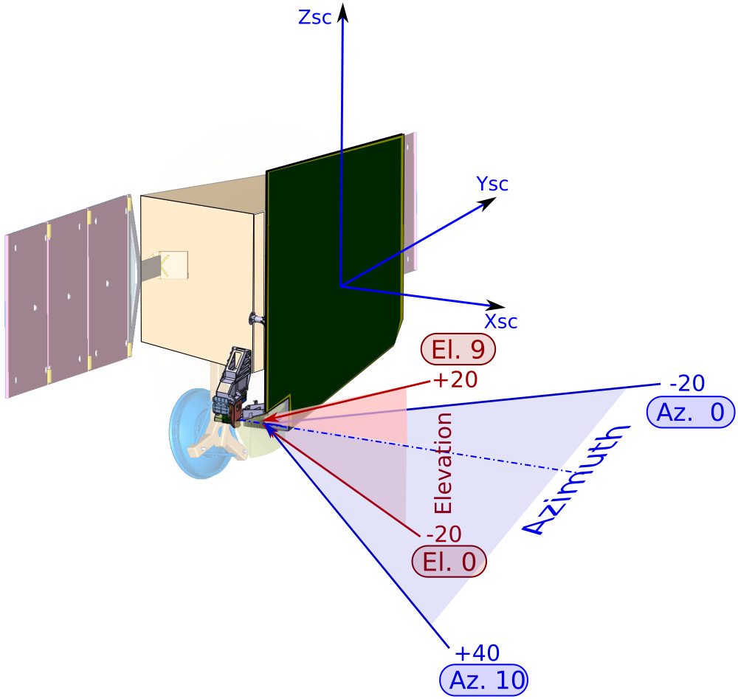
PAS location and frame
Notes:
2

Slide 3
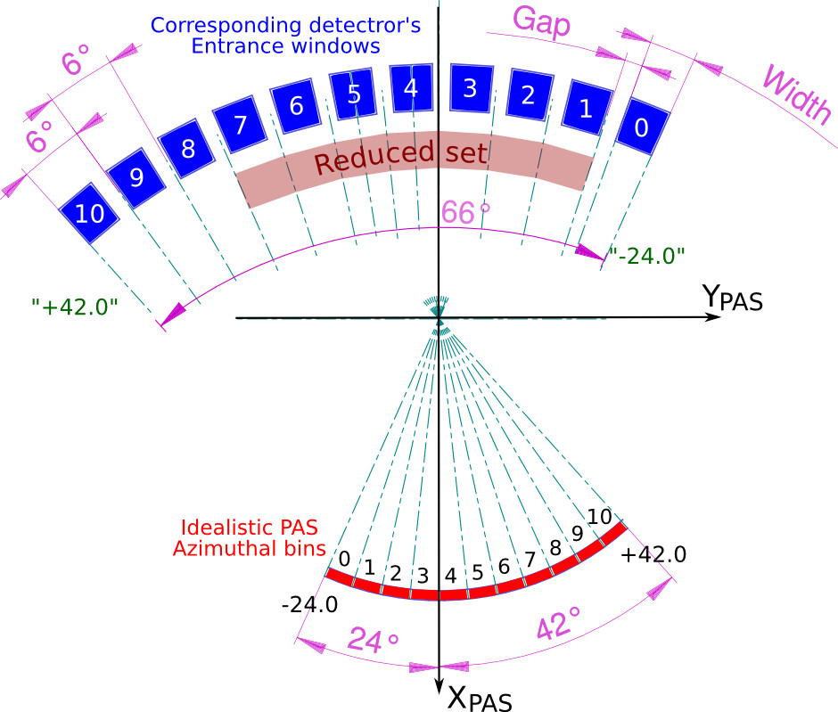
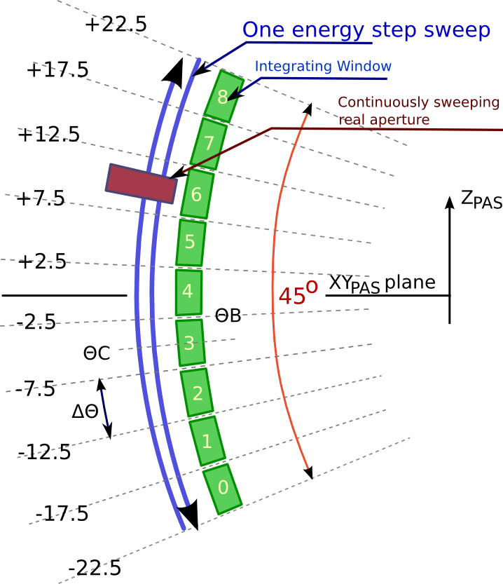
PAS location and frame
Azimuth bins
Elevation bins
-Zpas
Notes:
3

Slide 4
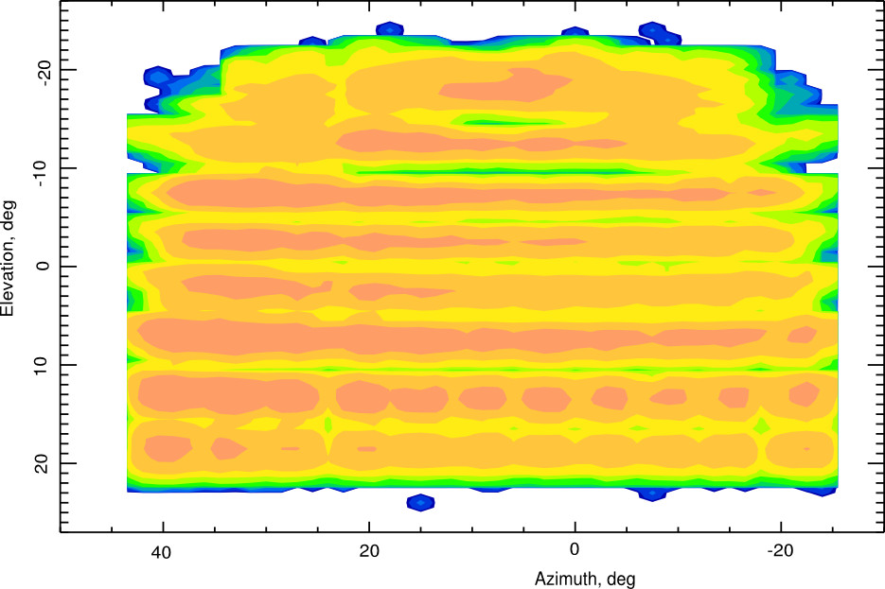
PAS Energies and Elevations
Notes:
4

Slide 5
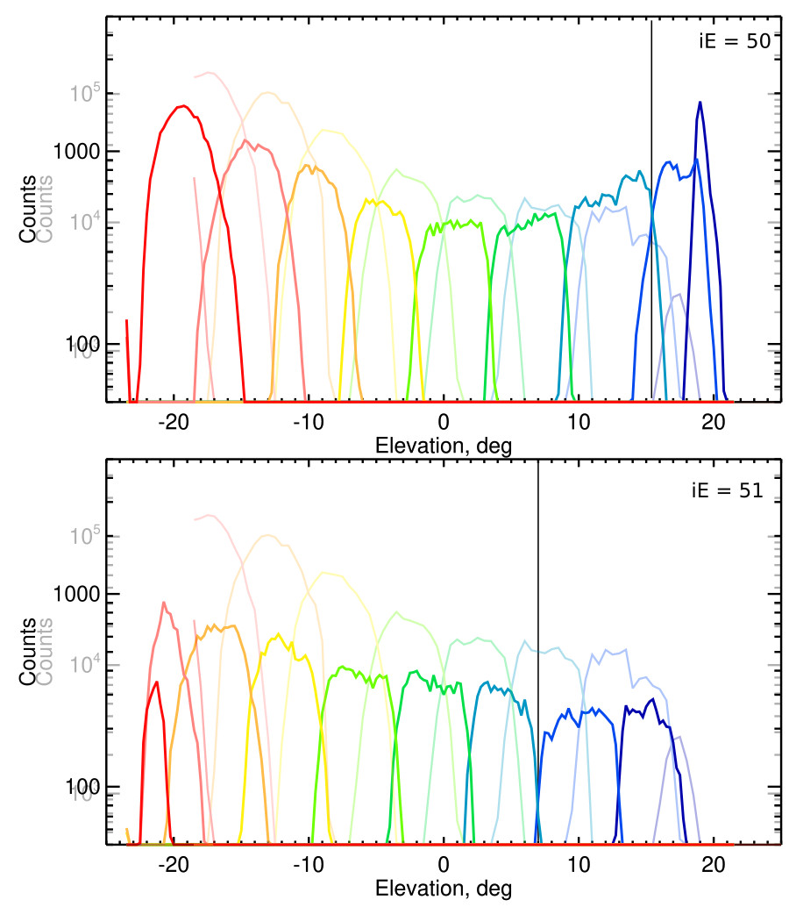
PAS sweeping
The figure on the left shows the elevation bins positions at the energy step 50 (top) (deflector voltage going up), and step 51 (bottom) (deflector voltage going down).
The light color responses are taken with quasi-static stepping.
The positions of the bins boundaries allows to obtain the real HV voltage in several points (see the previous slide).
Due to the shift between the time when the corresponding counter is open and the HV, the position of the bing are shifted up to 8°!

Slide 6
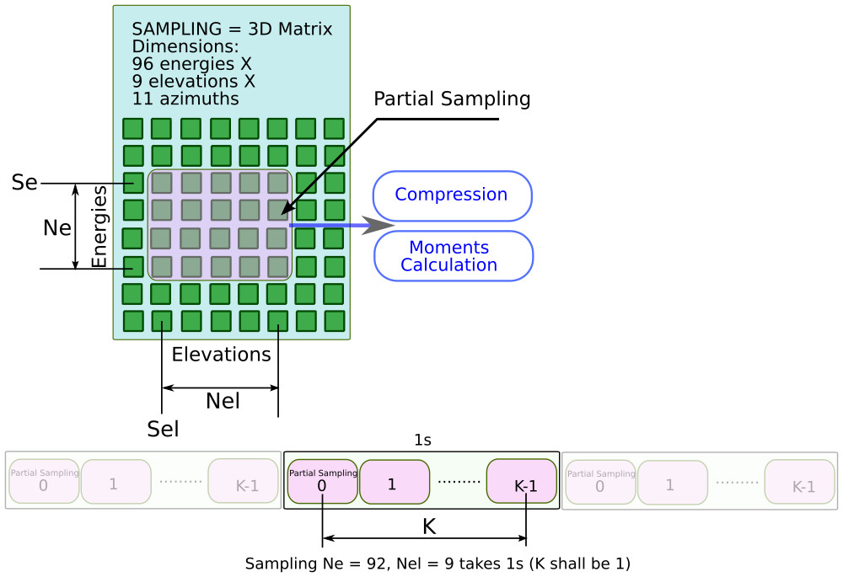
PAS samplings
PAS sampling is controlled by 5 parameters: Se, Ne, Sel, Nel, and K
If partial Samplig less the the maximal Sampling with factor >2 then we can locate K > 1 samplings inside one sec.

Slide 7
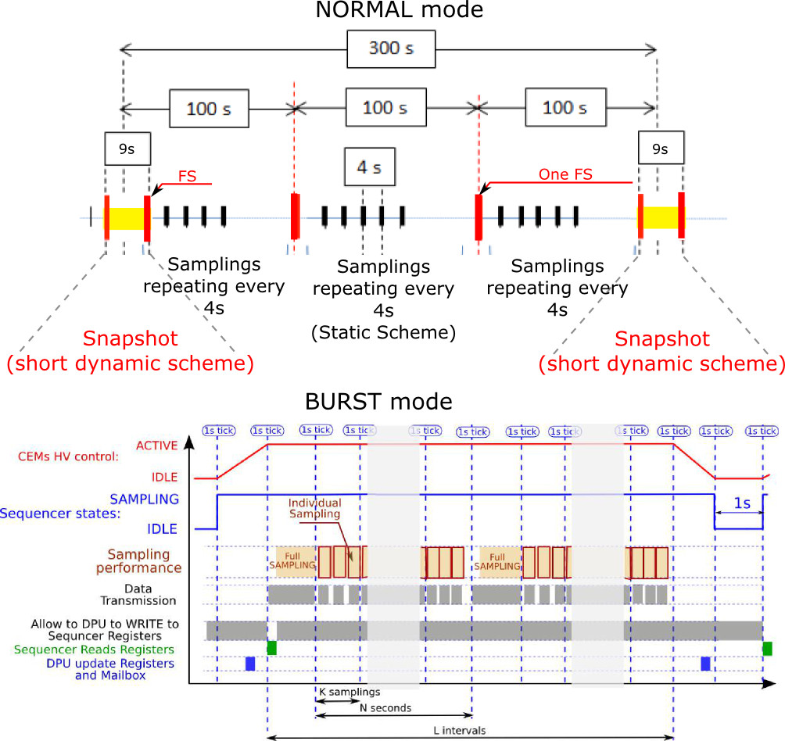
PAS samplings
By default:
Normal Sampling:
K=1, Se=24, Ne=48, Sel=1, Nel=5
Full 3D sampling:
K=1, Se= 4, Ne=92, Sel=0, Nel=9
Burst (and Snap)Mode Full Sampling:
K=1, Se= 4, Ne=92, Sel=0, Nel=9
N = 19
SnapShot Mode Sampling:
K=4, Ne=48, Nel=3
Burst Mode Sampling:
K=4, Ne=48, Nel=3

Slide 8
L2 CDF list (proposal)
What I would advise about L2 data:
3D samplings expressed in the differential fluxes (cm-2 s-1 eV-1)
3D samplings expressed as Distribution Function (cm-6 s-3 )
Ground calculated moments. Protons and Alpha, RTN fram
1D energy flux (cm-2 s-1 eV)
PAS – RTN transfer (for each sampling)
PAS energy table end directions in SolO system (one file depending to Calibration and Energy table)
See the CDFs contents in PAS_L2_Products_Contents.xlsx
Notes:
8

