Slide 1
SWA-EAS Data products
Gethyn Lewis, Chandra Anekallu
& Gill Watson

Slide 2
EAS Data Products
Full description in:
SWA Data Product Definition Document
SO-SWA-MSSL-IF-006
https://www.mssl.ucl.ac.uk/missions/SolO/Docs/SWA_Ops_Documents/SWA_Higher_Level_Data/
All data (and PAS & HIS) will be available at:
https://www.mssl.ucl.ac.uk/missions/SolO/Data/SWA/Flight_data/
Exact directory layout is TBD
NMc = Full 3D velocity distribution functions (VDFs) at
100 sec resolution Nominal
10 sec resolution High
400 sec resolution Low
TMc = 5 minutes of full 3D VDFs at 1 sec resolution captured around passage of an interplanetary shock. Triggered by RPW.
SS = Single Strahl. Single energy angle-angle distribution. Part of the Low Latency packets. 100 sec resolution cadence, off set from NM by 50 sec.
padc = Burst mode. 2D pitch angle distributions at 0.125 s resolution. Aligned parallel and anti parallel to the B field.
Onboard Partial Moments. Calculated on board in 3 energy and 4 angular ranges at 4 second resolution

Slide 3
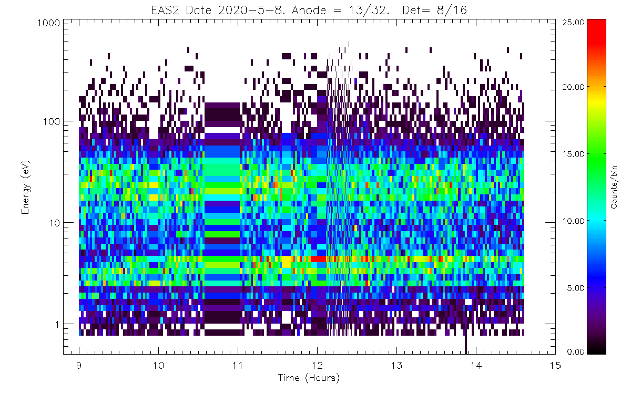
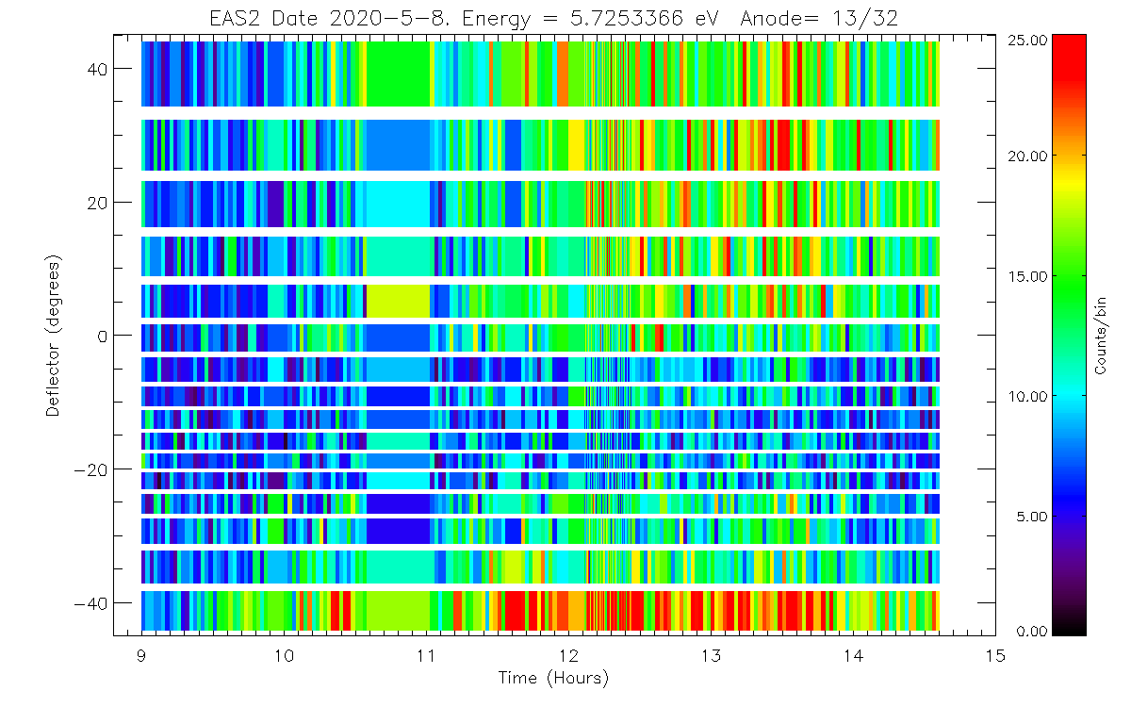
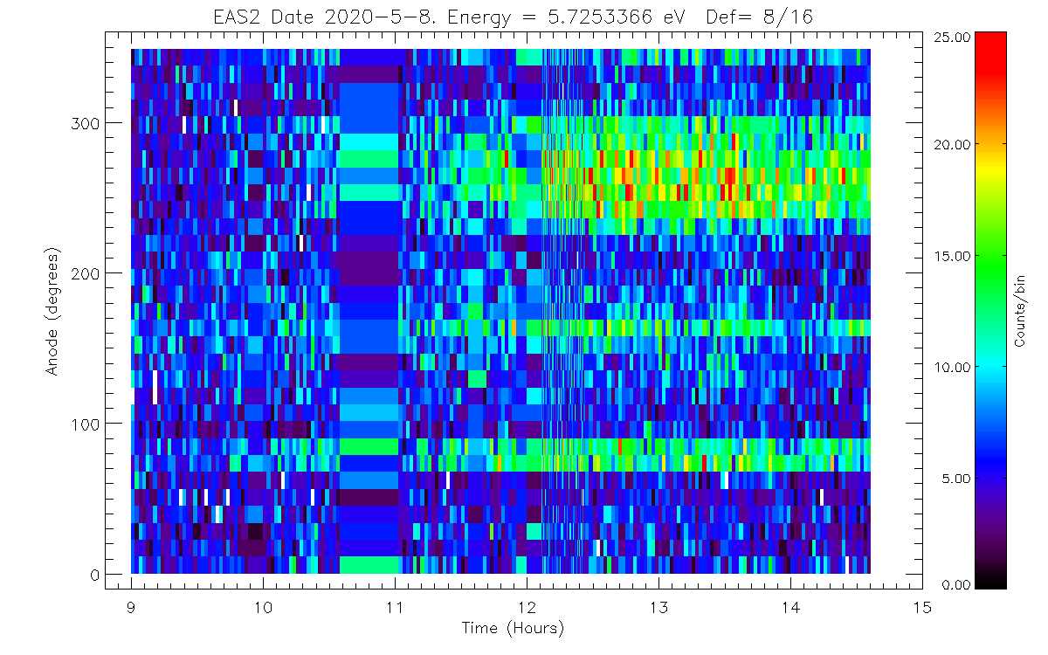
Normal Mode & Triggered Mode
solo_L1_swa-eas2-NM3D_20200508090000-20200508143820_V01.cdf
SWA_EAS2_SCET = Array[285]
SWA_EAS_ELEVATION = Array[16]
SWA_EAS_AZIMUTH = Array[32]
SWA_EAS2_ENERGY = Array[64, 285]
SWA_EAS2_Data = Array[32, 64, 16, 285]
SWA_EAS2_Mode = Array[3, 285]
SWA_EAS2_Full3DValidity = Array[285]
SWA_EAS2_ElevationValidity = Array[285]
SWA_EAS2_DataValidity = Array[64, 285]
QUALITY_FLAG = Array[285]
EAS Mode contains Energy table details. L0 -> L1
Validity flags indicate if data arrived at DPU from EAS. 0 = good
Triggered Mode is the same as Normal Mode, but there’s more of it.
TM packet also has trigger quality and potential
Single Strahl has the same format but only a single energy Array[32, 16, 285]
This is returned in the Low Latency data

Slide 4
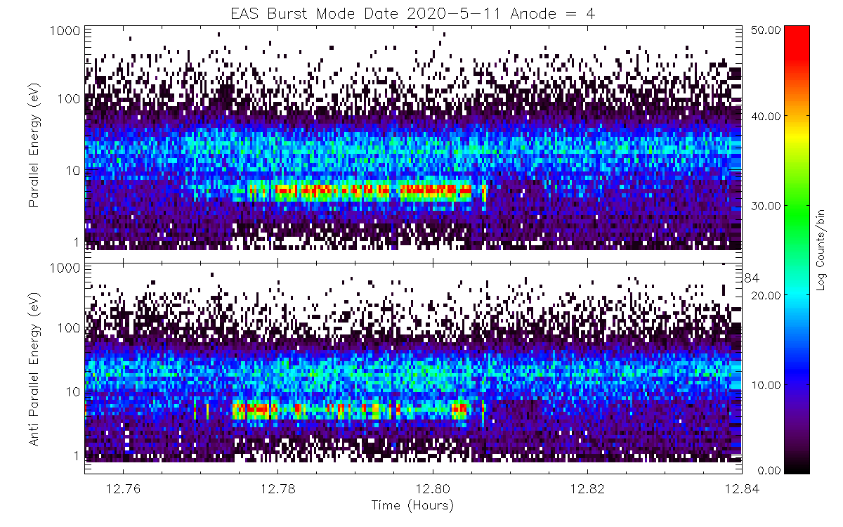
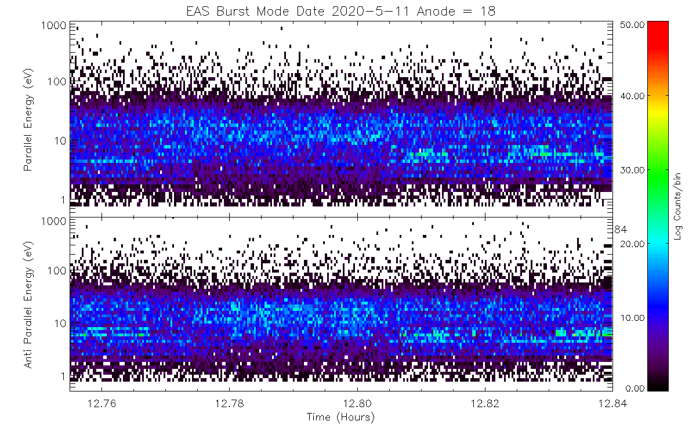
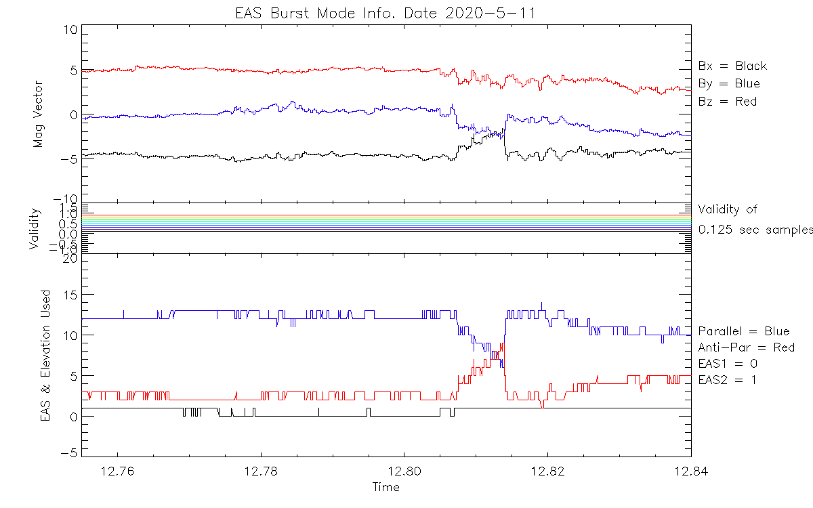
Burst Mode
solo_L1_swa-eas-2DBurstc_20200511115743-20200511131023_V01.cdf
SWA_EAS_SCET = Array[9597]
SWA_EAS_BM_Data = Array[32, 64, 2, 9597]
SWA_EAS_ENERGY = Array[64, 9597]
SWA_EAS_Mode = Array[3, 9597]
SWA_EAS_Validity = Array[9, 9597]
SWA_EAS_EasUsed = Array[9597]
SWA_EAS_ElevationUsed = Array[2, 9597]
SWA_EAS_MagDataUsed = Array[3, 9597]
SWA_EAS_MagVal = Array[9597]
Burst Mode packet is a combination of EAS1 & EAS2.
It contains a sample every 0.125 sec. 8 samples per second. At each sample B field is used to determine the “look direction” and then select appropriate deflector.
EAS Mode contains Energy table details. L0 -> L1
Validity flags indicate if data arrived at DPU from EAS. 0 = good
Validity is ‘bit packed’ to provide info on each energy bin, parallel and antiparallel.
Mag Validity tells if the input mag data was good.

Slide 5
Moments
1
SWA_EAS1_ONLY_LOW_ENE_N = Array[5284]
SWA_EAS1_ONLY_LOW_ENE_V = Array[3, 5284]
SWA_EAS1_ONLY_LOW_ENE_P = Array[6, 5284]
SWA_EAS1_ONLY_LOW_ENE_H = Array[3, 5284]
7
SWA_EAS2_ONLY_LOW_ENE_N = Array[5284]
SWA_EAS2_ONLY_LOW_ENE_V = Array[3, 5284]
SWA_EAS2_ONLY_LOW_ENE_P = Array[6, 5284]
SWA_EAS2_ONLY_LOW_ENE_H = Array[3, 5284]
Electron ‘Partial Moments’ calculated on board at 4 second resolution
Partial Moments returned:
Density
V_{X}, V_{Y}, V_{Z}
P₁₁, P₁₂, P₁₃,
P₂₁, P_{21,}
P₃₁
H_{X}, H₂, H₃
In 3 energy ranges: Low; Core; Strahl
4 angular ranges: EAS1; EAS2; ‘Overlap’
Also returned: SC Potential
2
SWA_EAS1_ONLY_CORE_HALO_N = Array[5284]
SWA_EAS1_ONLY_CORE_HALO_V = Array[3, 5284]
SWA_EAS1_ONLY_CORE_HALO_P = Array[6, 5284]
SWA_EAS1_ONLY_CORE_HALO_H = Array[3, 5284]
8
SWA_EAS2_ONLY_CORE_HALO_N = Array[5284]
SWA_EAS2_ONLY_CORE_HALO_V = Array[3, 5284]
SWA_EAS2_ONLY_CORE_HALO_P = Array[6, 5284]
SWA_EAS2_ONLY_CORE_HALO_H = Array[3, 5284]
3
SWA_EAS1_ONLY_STRAHL_N = Array[5284]
SWA_EAS1_ONLY_STRAHL_V = Array[3, 5284]
SWA_EAS1_ONLY_STRAHL_P = Array[6, 5284]
SWA_EAS1_ONLY_STRAHL_H = Array[3, 5284]
9
SWA_EAS2_ONLY_STRAHL_N = Array[5284]
SWA_EAS2_ONLY_STRAHL_V = Array[3, 5284]
SWA_EAS2_ONLY_STRAHL_P = Array[6, 5284]
SWA_EAS2_ONLY_STRAHL_H = Array[3, 5284]
4
SWA_EAS1_OVERLAP_LOW_ENE_N = Array[5284]
SWA_EAS1_OVERLAP_LOW_ENE_V = Array[3, 5284]
SWA_EAS1_OVERLAP_LOW_ENE_P = Array[6, 5284]
SWA_EAS1_OVERLAP_LOW_ENE_H = Array[3, 5284]
10
SWA_EAS2_OVERLAP_LOW_ENE_N = Array[5284]
SWA_EAS2_OVERLAP_LOW_ENE_V = Array[3, 5284]
SWA_EAS2_OVERLAP_LOW_ENE_P = Array[6, 5284]
SWA_EAS2_OVERLAP_LOW_ENE_H = Array[3, 5284]
SWA_EAS1_SCET = Array[5284]
SWA_EAS2_SCET = Array[5284]
SWA_EAS1_DATAVALIDITY = Array[5284]
SWA_EAS2_DATAVALIDITY = Array[5284]
SWA_EAS_SUMEAS1 = Array[5284]
SWA_EAS_SUMEAS2 = Array[5284]
SWA_EAS_SCPOTENTIAL = Array[5284]
SWA_EAS1_SUMMOMS = Array[12, 5284]
SWA_EAS2_SUMMOMS = Array[12, 5284]
5
SWA_EAS1_OVERLAP_CORE_HALO_N = Array[5284]
SWA_EAS1_OVERLAP_CORE_HALO_V = Array[3, 5284]
SWA_EAS1_OVERLAP_CORE_HALO_P = Array[6, 5284]
SWA_EAS1_OVERLAP_CORE_HALO_H = Array[3, 5284]
11
SWA_EAS2_OVERLAP_CORE_HALO_N = Array[5284]
SWA_EAS2_OVERLAP_CORE_HALO_V = Array[3, 5284]
SWA_EAS2_OVERLAP_CORE_HALO_P = Array[6, 5284]
SWA_EAS2_OVERLAP_CORE_HALO_H = Array[3, 5284]
6
SWA_EAS1_OVERLAP_STRAHL_N = Array[5284]
SWA_EAS1_OVERLAP_STRAHL_V = Array[3, 5284]
SWA_EAS1_OVERLAP_STRAHL_P = Array[6, 5284]
SWA_EAS1_OVERLAP_STRAHL_H = Array[3, 5284
12
SWA_EAS2_OVERLAP_STRAHL_N = Array[5284]
SWA_EAS2_OVERLAP_STRAHL_V = Array[3, 5284]
SWA_EAS2_OVERLAP_STRAHL_P = Array[6, 5284]
SWA_EAS2_OVERLAP_STRAHL_H = Array[3, 5284]

Slide 6
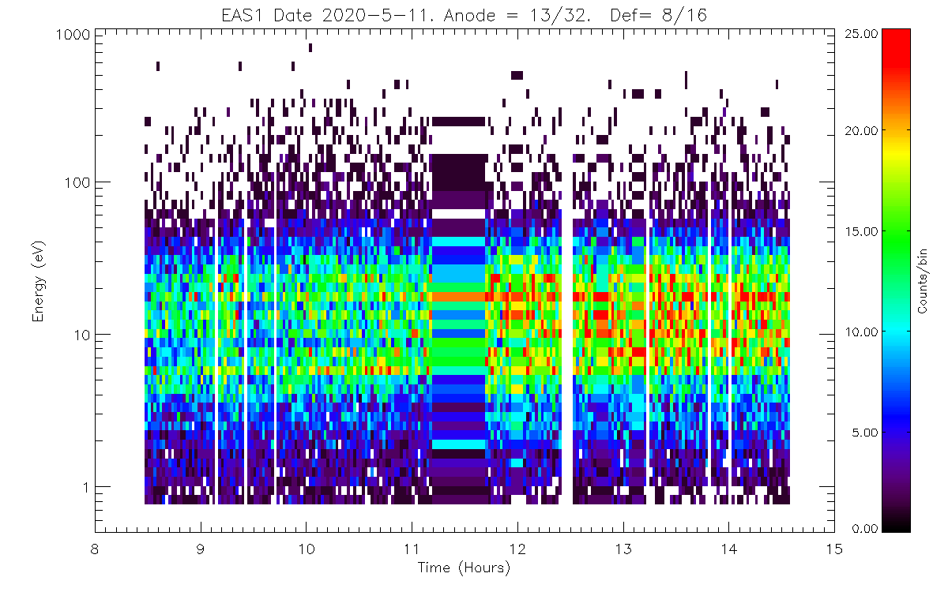
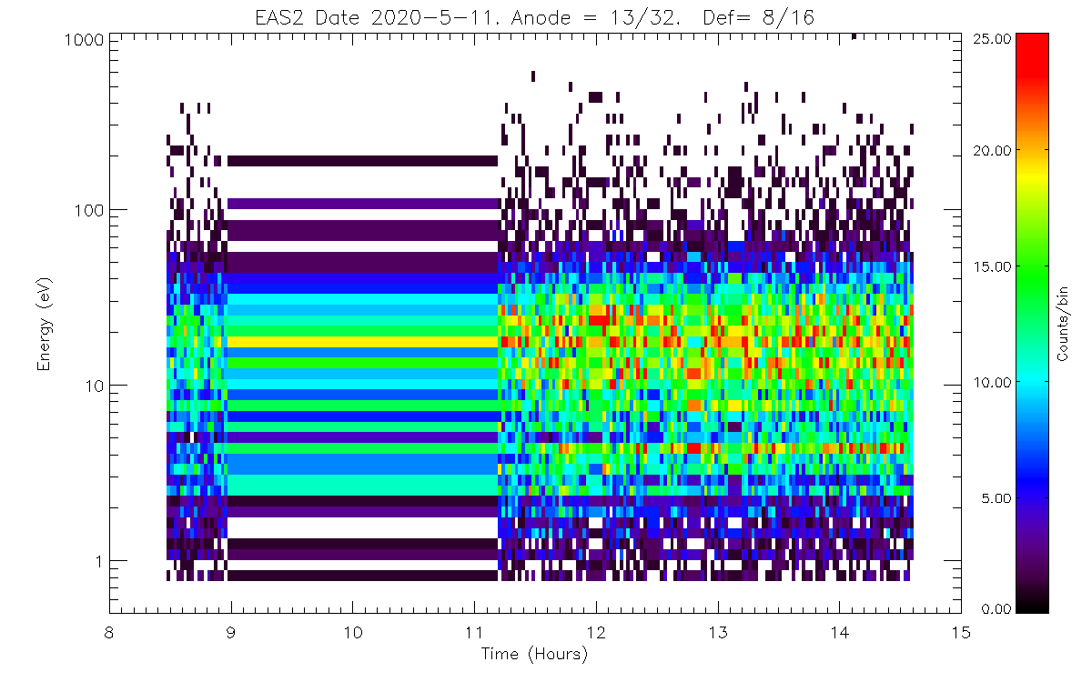
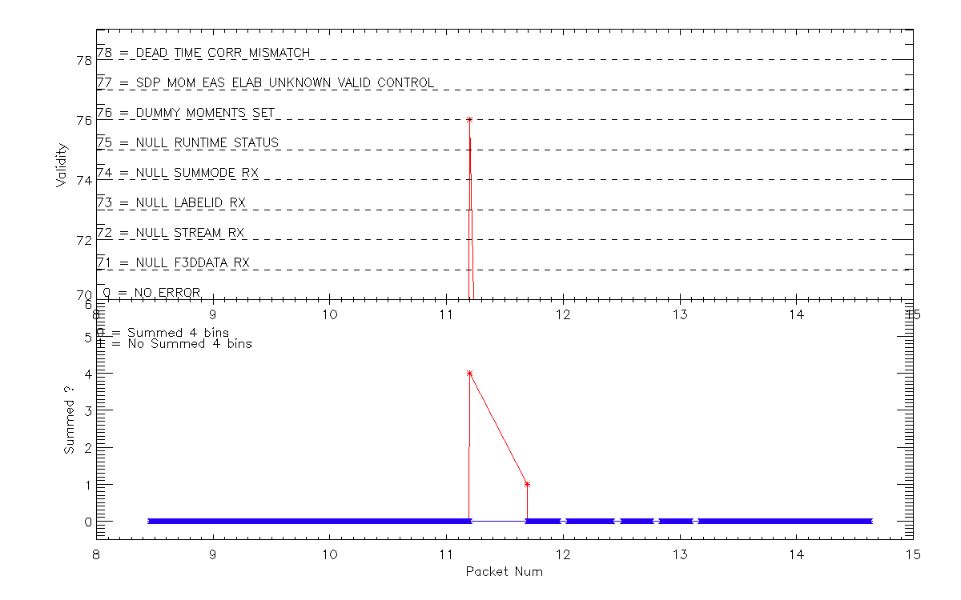
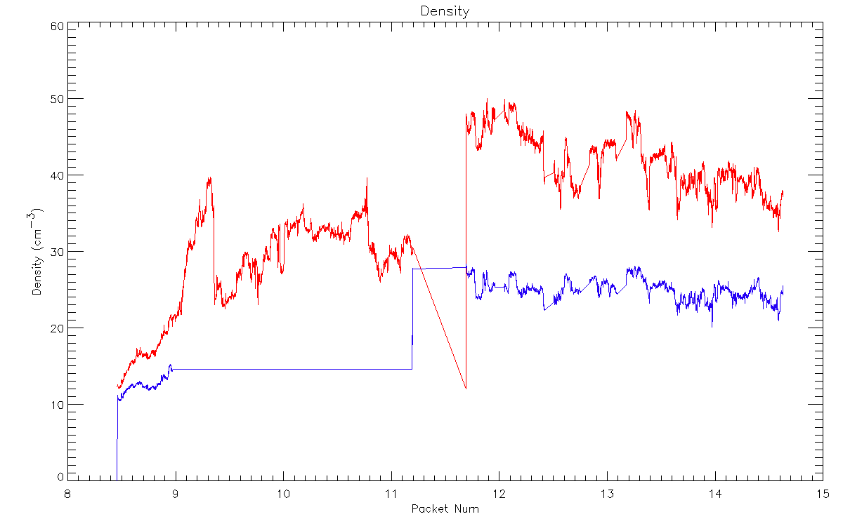
Moments
Electron ‘Partial Moments’ calculated on board at 4 second resolution
Partial Moments returned:
Density
V_{X}, V_{Y}, V_{Z}
P₁₁, P₁₂, P₁₃,
P₂₁, P_{21,}
P₃₁
H_{X}, H₂, H₃
In 3 energy ranges: Low; Core; Strahl
4 angular ranges: EAS1; EAS2; ‘Overlap’
Also returned: SC Potential
solo_L1_swa-eas-OnbPartMoms_20200511082732-20200511143744_V01.cdf
Energy boundaries are determined by bin number in the ‘Science Table’
Could change depending on the Energy table used.
Currently:
Low = 0.50 eV – 6.15 eV
Core = 7.00 eV – 29.00 eV
Strahl = 32 eV – 5 keV

Slide 7
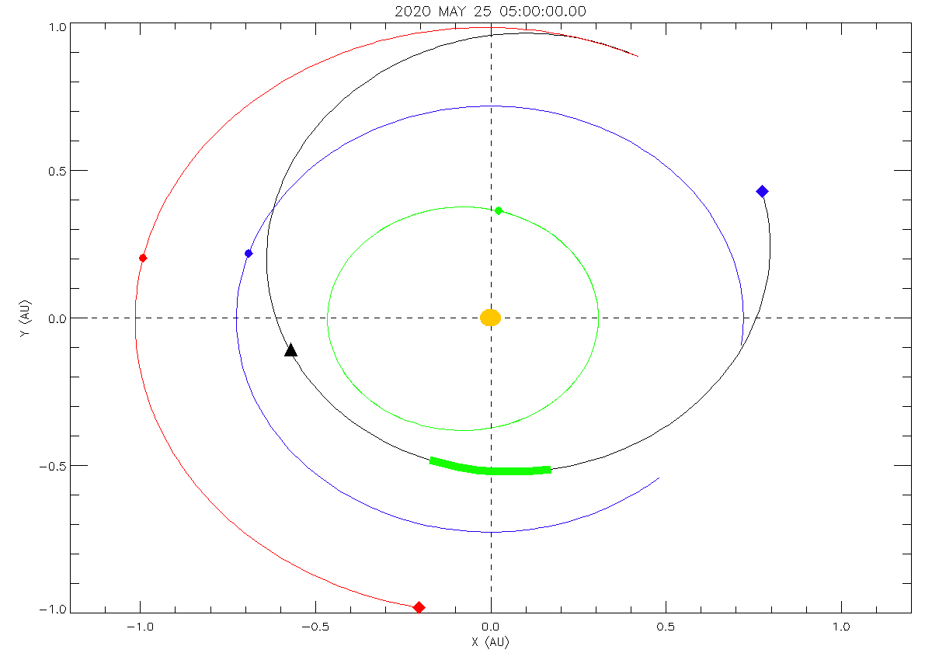
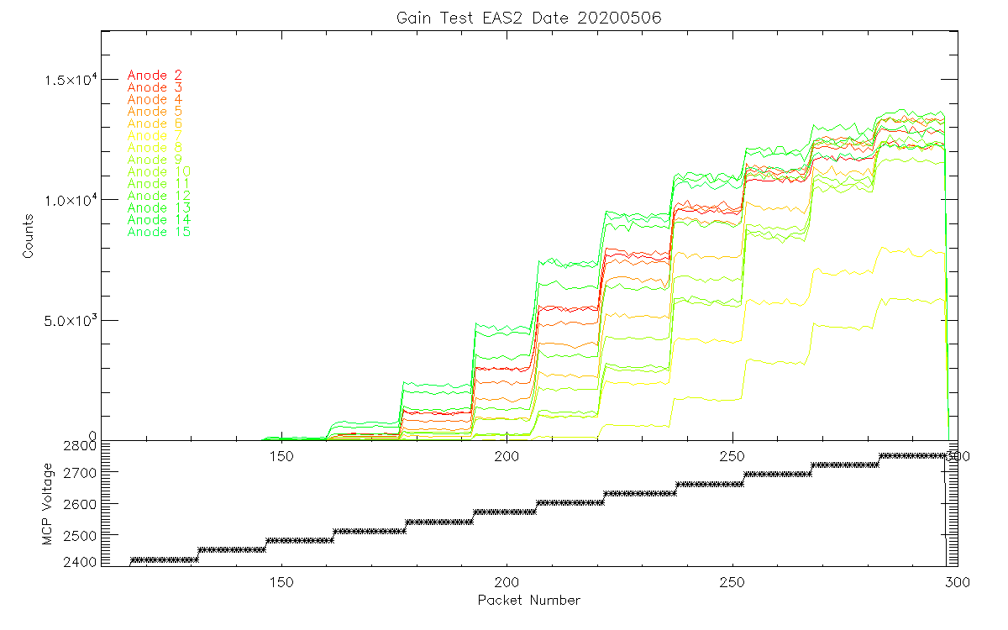
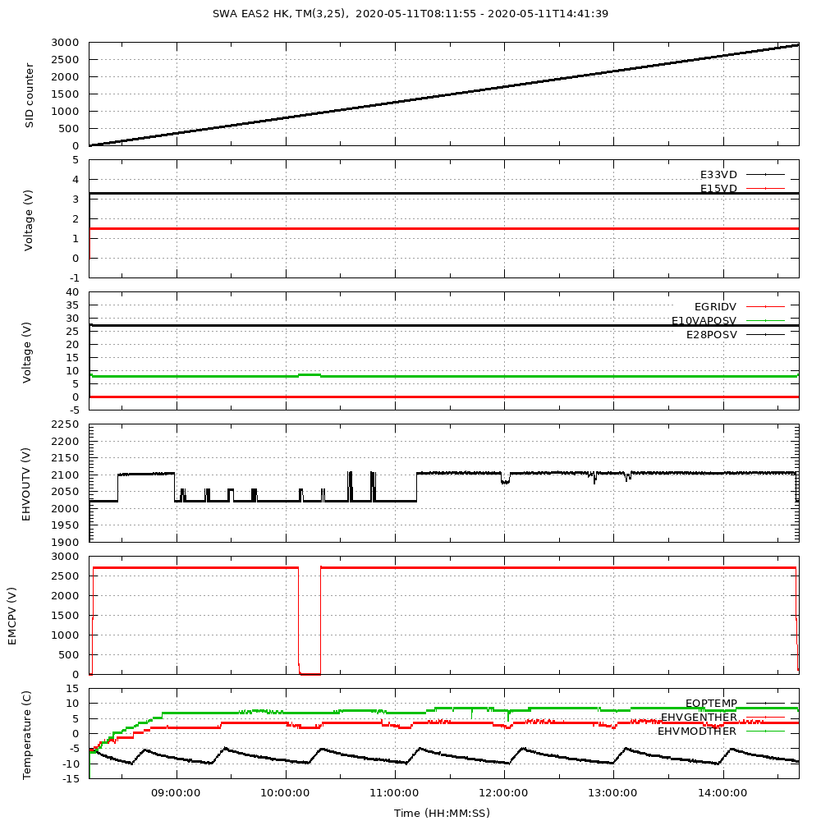
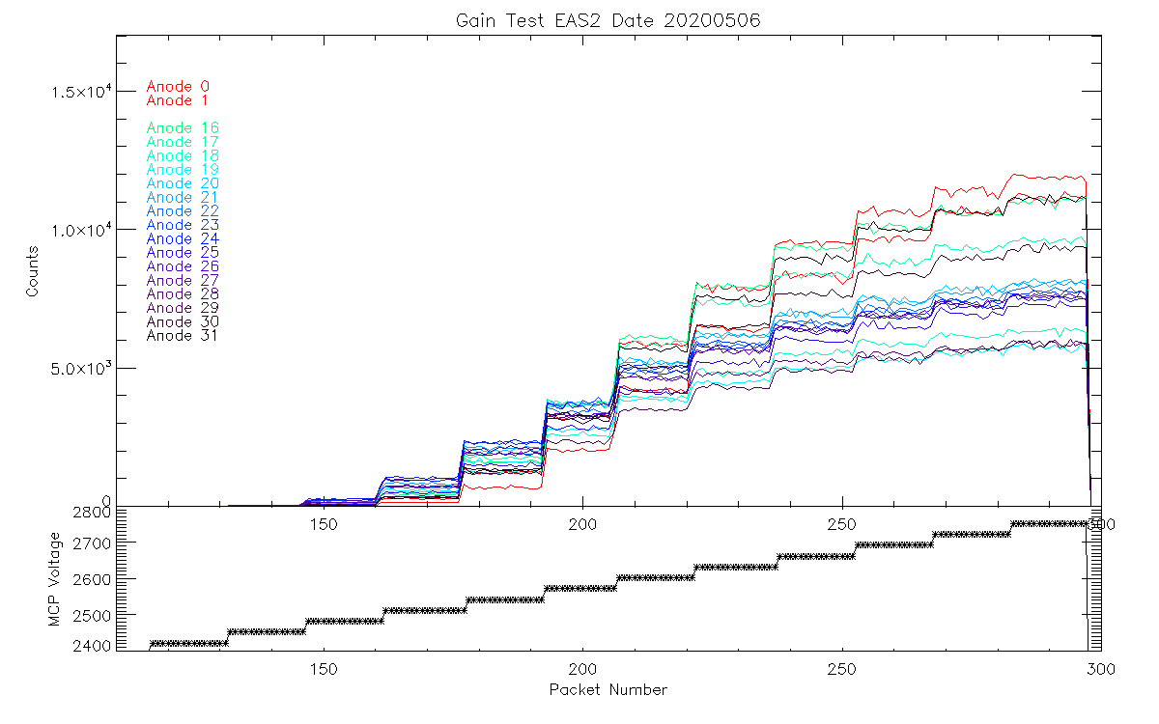
Ancilliary Data
HouseKeeping: Reports all temperatures and voltages for instrument safety
SPICE: All ephemeris data using SOC supplied kernels. Must be used with SPICE toolkit.
EAS Gain tests: Sweep MCP & Thresholds to monitor instrument performance.
Mag & RPW data available via the ISWG data sharing agreement from the SO archive (SOAR)
This is available before the 3 month data delivery but cannot be used for any publications. It is intended for
calibration purposes.

